Slide 1
Computer Programming 9
Introduction to Computer Science
Guiding Questions: What are the different components of a computer programming language? How are computer programming languages organized?
Course Challenges/Scenarios Setup:
This course will use a scaffolding approach to the learning of basic skills through mini challenges leading to a more App Challenges at the end of each section. The problem solving scenarios presented in the mini challenges will properly prepare students for the more complex App Challenges.
Occupational Areas:
BUSINESS
☐ Computing Science
☐ Enterprise & Innovation
☐ Management & Marketing
☐ Information Processing
Top skills that will get you hired
Skills Related to the Area:
- Students will learn about the many different components of computer programming languages through a simple computer programming language(Small Basic).
Safety and Environmental Concerns:
- Proper ergonomics, digital citizenship practices and hygiene concerns will be discussed with students as appropriate throughout the course.
Grade: 9
Interdisplinary Learning Opportunities:
SUBJECTS
☐ ELA
☐ Fine Arts
☐ Sciences
☐ Mathematics
Required Materials: Headphones

Slide 2
Course Overview
This course has been designed to provide you with the fundamental concepts of computer programming. Assignments in this course have been set up as “Challenges/Scenarios” that you must complete. Mini Challenges will be considered practice and only used for formative assessment. Summative assessments will be done with App Challenges and Show You Know assignments. The following model will be used for all challenges.
Design: To be completed before you start your project.
Create: To be completed as you complete your project.
Appraise: To be completed after your project is complete.
* App Challenges will include specific hand in templates. Details of how to hand in mini challenges will be given at the end of lessons.

Slide 3
What you will learn…
You will learn many computer science concepts throughout this course. Here are some of them…
Code as a set of instructions
Syntax(object, function, parameter, variable)
The coordinate system
Events
Conditionals
Loops
Kick Starter Video
Robotics

Slide 4
What is Hour of Code?
The Hour of Code is a one-hour introduction to computer science, designed to demystify code and show that anybody can learn the basics. Watch the following video to get an introduction to Computer Science.
http://hourofcode.com/us
Code.org

Slide 5
Mini Challenge: Problem solving with code
Use your problem solving skills to complete the Flappy Bird game!
Complete the “Make your own Flappy Bird” Hour of Code tutorial. Drag and drop code fragments to solve problems. Complete all levels and then right click on the certificate and “Save Picture As” to the hand in folder(J:CTS Computers/CTS 9/02 Computer Programming/HourOfCode).
Flappy Bird Tutorial (Get your headphones ready!)
Star Wars
Mine Craft

Slide 6
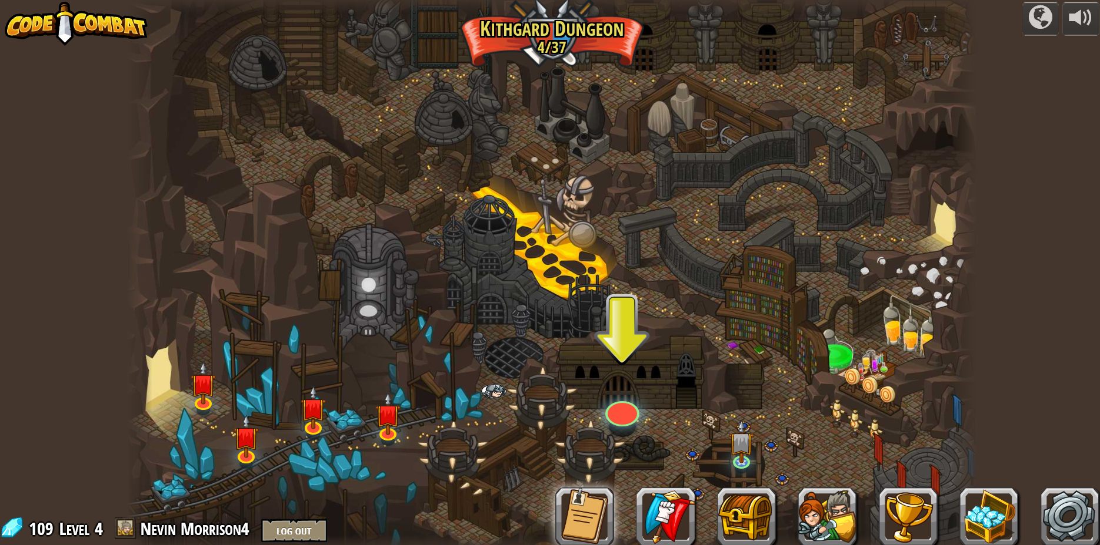
Mini Challenge 1.0: Intro to Writing Code
Conquer the Kithgard Dungeon in Code Combat!
In this challenge you will continue to solve problems with code. This time rather than dragging and dropping code fragments you will type simple commands. Set up an account at Code Combat and then conquer the Kithgard Dungeon challenge. When you complete level 18 screenshot the map(use the Snipping Tool) and save the image to the hand in folder. Remember to name the file in this format: lastnamefirstname2.

Slide 7
Download and Install Small Basic
For the remainder of this class we will be using the language “Small Basic” and working within its IDE (Integrated Development Environment”.
Install Small Basic by clicking on Programs→Windows System Center→Install Software→Microsoft Small Basic.
If you would like to work on Small Basic at home, click on the following link do download and install Small Basic on your computer.
http://download.microsoft.com/download/C/A/F/CAF9E062-94D3-4003-80D9-44CDF7EC7BD9/SmallBasic.msi

Slide 8
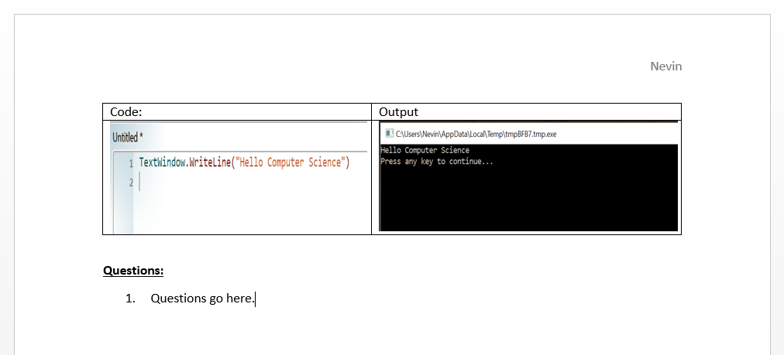
Small Basic Challenge(Lessons) Info:
After completing each mini challenge/lessons use the “Snipping Tool” to screenshot your code and output. Paste your screenshots into a word document (as shown below) so that your work can be evaluated. Answer any questions that may be included at end of the of the challenge in the word document. Save the word document to the hand in folder ex. LastnameFirstAssign1.1.

