Slide 1
Microsoft® Small Basic
Statements, Properties, and Operations
Estimated time to complete this lesson: 1 hour

Slide 2
Statements, Properties, and Operations
In this lesson, you will learn about:
Statements in Small Basic programs.
Properties of the TextWindow object.
Operations of the TextWindow object.

Slide 3
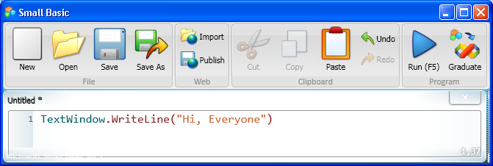
Statements in Small Basic Programs
When you give an instruction to the computer, you create a statement. You can write a program by creating just one statement or by creating two or more statements in a particular sequence.
For example, you can instruct the computer to open a text window and write "Hi, Everyone" in it. To give this instruction, you write the following statement in the Editor:
Notes:
One ore more statements make up a program in Small Basic. The computer runs a program by reading and understanding each statement line by line.
For example, this screen displays the statement: TextWindow.WriteLine("Hi, Everyone")
This statement tells the computer to write the line of text, Hi, Everyone, in the text window.

Slide 4
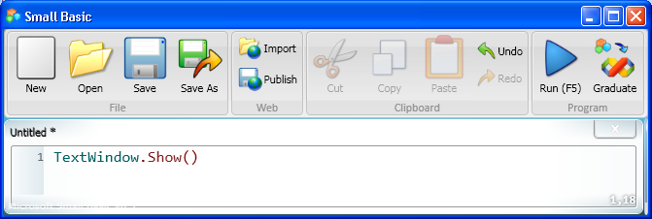
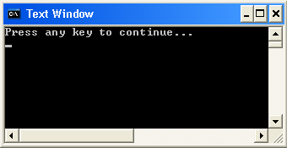
Showing and Hiding the Text Window
The text window is an object, and you can instruct the computer to perform operations on that object. For example, you can display the TextWindow object by using the Show operation.
output
Click the button on the Toolbar.
Similarly, you can hide the TextWindow object by using the Hide operation.
Notes:
Let’s see how you can show or hide the text window.
First, type TextWindow.Show() in the Editor, and then click Run on the Toolbar. The result of your program is that the text window appears.
Similarly, you can hide the text window if you type the statement TextWindow.Hide() in the Editor and then click Run on the Toolbar.

Slide 5
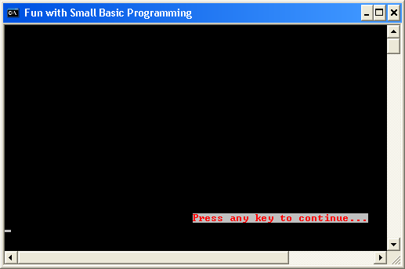
Properties of the TextWindow Object
The TextWindow object has a specific set of properties, such as ForegroundColor, BackgroundColor, Title, CursorTop, CursorLeft, Top, and Left. You can use these properties to change how and where the TextWindow object appears.
output
Notes:
In the previous screen, we talked about an object called TextWindow. Small Basic contains many more objects. These objects have certain properties, operations, or events attached to them.
Let’s understand the properties and operations of a text window and how we can use them.
In the code that appears here, you set the background color of the TextWindow object to gray and the foreground color to red. Similarly, you specify a title for the text window, the position of the cursor in the text window, and the location where you want the window to appear on the screen.
To better understand this code, let’s check the output of your program after you run it!
As you see in the output, the default text Press any key to continue… appears in red with a gray background. This is because you set the BackgroundColor property of the text window to Gray and the ForegroundColor property to Red.
Notice that the title of the text window is Fun with Small Basic Programming. You specified this title by using the Title property of the TextWindow object.
The CursorTop property indicates the row position of the cursor in the text window, and the CursorLeft property indicates the column position of the cursor. You had set these values by using the CursorTop and CursorLeft properties.
Similarly, the Top property and the Left property indicate the top position and the left position of the text window on the screen.
Code:
TextWindow.BackgroundColor = "Gray"
TextWindow.ForegroundColor = "Red"
TextWindow.Title = "Fun with Small Basic Programming"
TextWindow.CursorTop = 20
TextWindow.CursorLeft = 30
TextWindow.Top = 300
TextWindow.Left = 300

Slide 6
Operations of the TextWindow Object
For the TextWindow object, you can specify the following operations:
Show
Hide
Write
WriteLine
Read
Pause
Clear
Let’s explore some of these operations…
Notes:
In addition to the Show and Hide operations, you can also perform other actions or operations on the TextWindow object.

Slide 7
Writing Text in the Text Window
You have already learned how to show and hide the text window. Now let’s see how you can write text in the TextWindow object.
As you see, this operation wrote both sentences on the same line with no space between them. But don’t worry: you can use a different operation to show these sentences on separate lines.
Notes:
You can write text in the text window by using the Write operation of the TextWindow object.
Code:
TextWindow.Write("Hi, everyone!")
TextWindow.Write("How are you doing?")

Slide 8
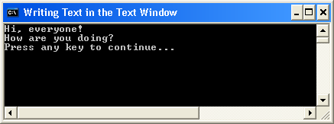
Writing Text in the Text Window
Write and WriteLine are both operations of the TextWindow object. If you use the WriteLine operation, each line of text appears on a separate line.
Notes:
To write the text on separate lines, you use the WriteLine operation.
Code:
TextWindow.WriteLine("Hi, everyone!")
TextWindow.WriteLine("How are you doing?")

Slide 9
Reading a Line of Text
Would you like the computer to ask for your name and a friend’s name and then say "Hello" to both of you? Let’s see how to make that happen.
If you use the Read operation, the computer reads and remembers what a user has typed. If you use the WriteLine operation, the computer displays the information from the user.
Notes:
The Read operation of the TextWindow object takes no input. This operation instructs the computer to wait while the user types in text and then presses ENTER. After the user presses ENTER , the program reads what the user has typed and stores it in memory. You can then use the Write operation or the WriteLine operation to display the stored information.
Code:
TextWindow.Write("Enter your name: ")
name = TextWindow.Read()
TextWindow.WriteLine("Hello " + name + ".")

Slide 10
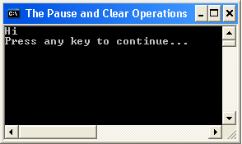
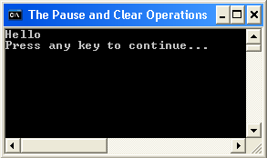
The Pause and Clear Operations
If you use the Pause operation, the computer waits for user input before returning the final output.
If you use the Clear operation, the computer clears all text from the text window.
Let’s write a program to better understand these operations.
Notes:
When the program starts, the computer reads the first statement, which contains the first WriteLine operation. The computer opens the text window and writes the word “Hi” in it.
The computer then reads the second statement, which contains the Pause operation. The computer pauses and waits for user input.
After the user provides input, the computer reads the third statement, which contains the Clear operation. The computer clears the word “Hi” from the text window.
Finally, the computer reads the last statement, which contains the second WriteLine operation. The computer writes the word “Hello” in the text window.
Code:
TextWindow.WriteLine("Hi")
TextWindow.Pause()
TextWindow.Clear()
TextWindow.WriteLine("Hello")

Slide 11
Let’s Summarize…
Congratulations! Now you know how to:
Write statements for programs in Small Basic.
Change various properties of the TextWindow object, such as its title and its location.
Use various operations of the TextWindow object, such as Show and WriteLine.

Slide 12
Mini Challenge 1.2: Manipulating Properties.
Write a program to display a text window and perform the following steps:
Set the top position of the text window to 100, and set its left position to 200.
Write a statement that makes “Small Basic Programming” appear in the title bar of the text window.
Set the top position of the cursor to 10 and left position to 20.
Set the foreground color of the text to yellow.
Display the sentence, “Welcome Your Name to the world of Small Basic programming.”
- Use the Snipping Tool to save your results. Hand in the image to the hand in folder.
Question:
What different properties can UI objects have? How are they manipulated?

