Slide 1
Microsoft® Small Basic
Conditions and Loops
Estimated time to complete this lesson: 2 hours

Slide 2
Conditions and Loops
In this lesson, you will learn how to:
Write programs that carry out different instructions based on whether one or more logical conditions are true.
Write programs that repeat instructions until a specific event occurs.

Slide 3
Conditions in Small Basic Programs
Would you like to specify conditions that control how your program runs (or whether it runs at all)?
Let’s look at the following program:
This program instructs the computer to display "Happy New Year" only if today is January 1st.
Notice that this program contains the If, Then, and EndIf keywords.
Notes:
In Small Basic, you use the Clock object to determine the current date and time.
You use the If keyword to specify a condition that the computer evaluates to determine whether it should perform a particular operation. You use the Then keyword to specify what operation or operations the computer should perform if the condition is true. If the condition is false, the computer skips the operation or operations and proceeds to the next line of the program. You use the EndIf keyword to indicate that the computer should proceed to the next line of the program regardless of whether the condition was true.
In this example, you use the If keyword specify the condition that today is the first day of the first month of the year (January). You use the Then keyword to specify that, if today is the first day of the first month, the computer should run the WriteLine operation. If today is not the first day of the first month, the computer should skip the operation and proceed to the EndIf line of the program.
Code:
If Clock.Day = 1 And Clock.Month = 1 Then
TextWindow.WriteLine("Happy New Year")
EndIf

Slide 4
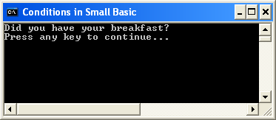
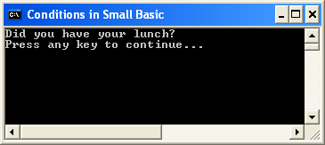
Conditions in Small Basic Programs
Now, let’s write a program in which you specify an alternate action to perform if the condition is false.
Depending on when you run the program, the computer displays one of the following results:
Notes:
Code:
If Clock.Hour < 12 then
TextWindow.WriteLine("Did you have your breakfast?")
EndIf
If Clock.Hour > 12 then
TextWindow.WriteLine("Did you have your lunch?")
EndIf

Slide 5
Conditions in Small Basic Programs
In programming, you can do that same thing in more than one way. As a programmer, you can choose the best way.
In this example, you might have noticed that the second condition in the program repeats a lot of information in the first condition.
Let’s reduce the repetition by using the Else keyword.
Both programs give the same result, but you can use fewer If, Then, and EndIf keywords if you use the Else keyword.
Notes:
In this program, you specify a condition and an operation to perform if that condition is true. Then you specify a second condition and a second operation to perform if the second condition is true. However, the first condition is true only if the second condition is false, and the second condition is true only if the first condition is false. Therefore, you don’t need to specify the second condition because the computer can determine which operation to perform based only on the first condition. Instead of giving the computer two conditions to evaluate, you can specify that the computer should perform the first operation if the first condition is true and the computer should perform the second operation if the first condition is false.
The result of both approaches is the same. This example shows that you can do the same thing in different ways in programming. It’s up to you!
Code:
If Clock.Hour < 12 Then
TextWindow.WriteLine("Did you have your breakfast?")
Else
TextWindow.WriteLine("Did you have your lunch?")
EndIf

Slide 6
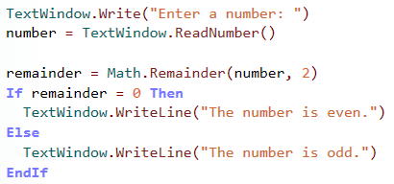
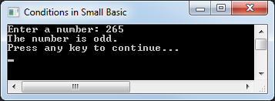
Conditions in Small Basic Programs
Let’s look at another example…
You are writing a complex program, and you want to check whether the user typed an even number or an odd number.
output
Notice the use of If, Then, Else, and EndIf in the program.
Notes:
In this program, you first ask the user for a number. Then you create a variable to store the number, and you use the ReadNumber operation to determine what number the user specified.
Next, you create a variable to store the remainder after you divide the user’s number by 2, and you use the Math.Remainder operation to determine whether the remainder is 0.
Finally, you specify that the number is even if the remainder is 0 and that the number is odd if the remainder is not 0.
Code:
TextWindow.Write("Enter a number: ")
number = TextWindow.ReadNumber()
remainder = Math.Remainder(number, 2)
If remainder = 0 Then
TextWindow.WriteLine("The number is even.")
Else
TextWindow.WriteLine("The number is odd.")
EndIf

Slide 7
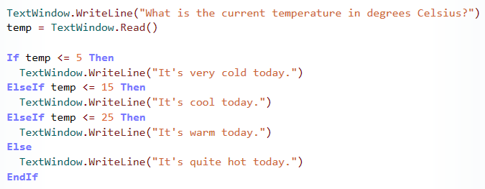
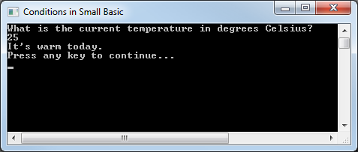
Conditions in Small Basic Programs
When you write a program, you can specify as many conditions as you want by using the ElseIf keyword. You can also specify one or more operations for the computer to perform, depending on which condition is true when your program is run.
Let’s look at this with an example.
In this example, each condition contains a unique statement that the computer evaluates. When the computer evaluates a statement as true, the computer performs the operation for that condition and then proceeds to the end.
Notes:
Code:
TextWindow.WriteLine("What is the current temperature in degrees Celsius? ")
temp = TextWindow.Read()
If temp <= 5 Then
TextWindow.WriteLine("It’s very cold today.")
ElseIf temp <= 15 Then
TextWindow.WriteLine("It’s cool today.")
ElseIf temp <= 25 Then
TextWindow.WriteLine("It’s warm today.")
Else
TextWindow.WriteLine("It’s quite hot today.")
EndIf

Slide 8
Loops in Small Basic Programs
You can use a loop to instruct the computer to run one or more statements more than once.
You can use a For loop if you know how many times you want the computer to repeat the instructions.
You can use a While loop if you want the program to repeat the instructions until a specific condition is true.
So, let’s explore some loop statements…

Slide 9
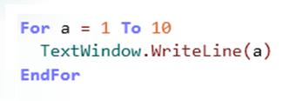
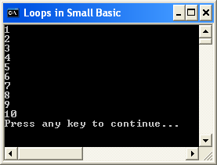
Loops in Small Basic Programs
Let’s start by writing a program that contains a For..EndFor loop.
In general, you use a For..EndFor loop to run code a specific number of times. To manage this type of loop, you create a variable that tracks how many times the loop has run.
Click the button on the Toolbar.
In this example, the variable contains a value that increases by 1 every time that the loop runs.
Notes:
Code:
For a = 1 to 10
TextWindow.WriteLine(a)
EndFor

Slide 10
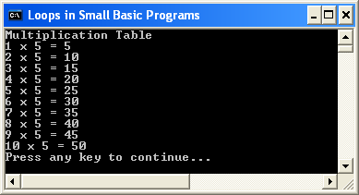
Loops in Small Basic Programs
Let’s use this concept to print the multiplication table for the number 5.
output
Notes:
In this program, you first use the WriteLine operation to display "Multiplication Table" on the screen.
Then you create the variable “number” to store the value of 5.
Then you create a For loop with the variable “a” to ensure the WriteLine operation will run 10 times.
You use the WriteLine operation to display the following elements in this order:
--the value that is stored in the “a” variable --the multiplication sign
--the value that is stored in the “number” variable
--the equals sign
--the products of the values of the “a” and “number” variables
Code:
TextWindow.WriteLine("Multiplication Table")
number = 5
For a = 1 to 10
TextWindow.WriteLine(a + " x " + number + " = " + a * number)
EndFor

Slide 11
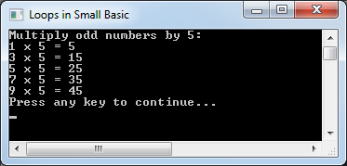
Loops in Small Basic Programs
In the previous example, the value of the counter variable in a For loop increases by 1 every time the loop runs. However, you can increase the value by another number if you use the Step keyword.
For example, you can increase the value by 2 if you write the following code:
Notes:
You can even decrease the value of the loop variable every time that the code runs if you use the Step keyword but specify a negative number. For example, you can write a program that counts backward from 10 to 1 on the screen if you assign the value of -1 to the Step keyword.
Code:
TextWindow.WriteLine("Multiply odd numbers by 5:")
number = 5
For a = 1 to 10 Step 2
TextWindow.WriteLine(a + " x " + number + " = " + a * number)
EndFor

Slide 12
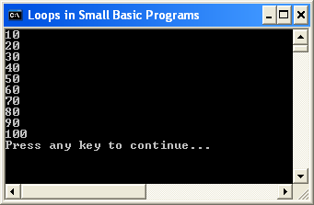
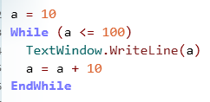
Loops in Small Basic Programs
If you don’t know the loop count before you write a program, you can create a While loop instead of a For loop.
When you create a While loop, you specify a condition that is true when the loop starts. But the computer evaluates the condition every time that the loop repeats. When the condition becomes false, the loop stops.
Let’s write the following program to demonstrate the While loop:
Notes:
In this example, you first create the “a” variable and set its value to 10.
Next, you create a While loop with a condition that the value of the “a” variable is smaller than or equal to 100. Because you just set the value of that variable to 10, the condition is true when the loop starts.
You use the WriteLine operation to display the value of the “a” variable every time that the loop runs.
In the next statement, you increase the value of the “a” variable by 10 every time that the loop runs.
The loop stops after it runs 10 times because the value of the “a” variable becomes larger than 100.
Code:
a = 10
While (a <= 100)
TextWindow.WriteLine(a)
a = a +10
EndWhile

Slide 13
Let’s Summarize…
Congratulations! Now you know how to:
Write programs that evaluate logical conditions and perform operations based on those results.
Write programs that repeat one or more instructions either a specific number of times or based a logical condition.

Slide 14
Challenge 1.4: Part A: Grade Calculator
Create a program to convert a percentage score into a letter grade. Convert the scores into a letter grade based on the following criteria:
Part A: Grade Calculator
If the percentage is more than 75, convert it to an A.
If the percentage is less than 75 but more than or equal to 60, convert it to a B.
If the percentage is less than 60 but more than or equal to 35, convert it to a C.
If the percentage is less than 35, convert it to a D.
Display the information in the following format. “Your grade is _____, you receive a(n) ___.”
- Continue to next slide for Part B

Slide 15
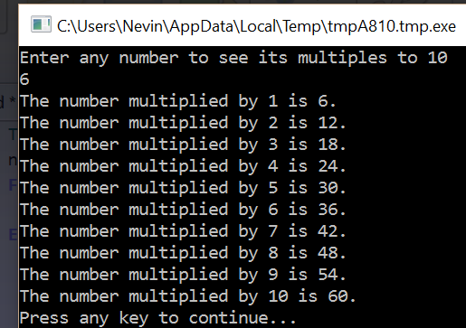
Challenge 1.4: Part B: Multiplier
Create a program that will show the multiples of any number entered to 10. Use a For Loop to complete this task.
Part B: Multiplier
Ask the user to enter any number to see its multiples to 10.
Loop through and display the multiples of the number to 10 in the following format:
Refer to slide 10 for help.
Continue to next slide for Part C.

Slide 16
Mini Challenge 1.4: Part C: Number Guesser
Create a program that asks the user to guess a number between 1 and 10. When the user guesses wrong tell the user to guess higher or lower based on their guess. When the user guesses correct display “You Win”.
Hints:
- To get a random number in small Basic enter: Math.GetRandomNumber(maxNumber)
- The “Not Equal” operator in small Basic is “<>”.
* Use a While Loop with a If …ElseIf statement in the loop.
Part C: Number Guesser
Set a random number between 1-10.
Ask the user to guess a number between 1 -10.
Create a While Loop that check to see if the number guessed is equal to the random number.
Create an If …Elseif statement that displays get higher or lower based on the users guess.
If the guess is correct display “You Win”.
- Use the snipping tool to save your results to a word document hand in parts A, B and C together. Answer the questions on the right.
Questions:
What is a condition used for? What kind of statements can you use to write a condition? Give two examples.
What are loops used for? What are two types of loops? Give examples of each.

