Slide 1
Microsoft® Small Basic
Clock, Desktop, and Dictionary Objects
Estimated time to complete this lesson: 1 hour

Slide 2
Clock, Desktop, and Dictionary Objects
In this lesson, you will learn how to:
Use different properties of the Clock object.
Use different properties and operations of the Desktop object.
Use different operations of the Dictionary object.

Slide 3
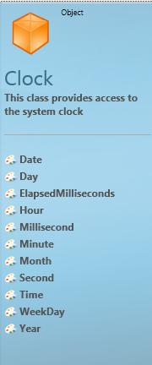
The Clock Object
As you program, you may encounter situations where you need to calculate time or perform certain actions based on the date and time.
By using the Clock object, you can include this logic in your programs and write programs that use the system clock. This object’s properties include Date, Hour, Time, and Year.
Let’s explore some properties of the Clock object…

Slide 4
Date, Weekday, and Time
You can get the current system date, day of the week, and time by using the Date property, the WeekDay property, and the Time property, respectively.
Let’s look at an example that displays this information in the graphics window…
output
Notes:
In this example, we have used the DrawBoundText operation of the GraphicsWindow object. This operation displays a line of text at a location that you indicate by specifying an x-coordinate and a y-coordinate. The text for this example starts at the location that we indicated by specifying an x-coordinate of 40 and and a y-coordinate of 40.
Code:
date = Clock.Date
weekday = Clock.WeekDay
time = Clock.Time
display = ("Current Date: " + date + "," + "Current Weekday: " + weekday + "," + " Current Time: " + time)
GraphicsWindow.DrawBoundText(40, 40, GraphicsWindow.Width, display)

Slide 5
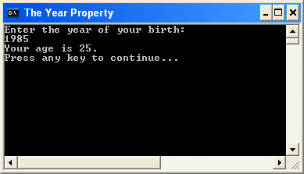
The Year Property
You can use the Year property of the Clock object to get the current system year.
Let’s take an example that uses this property to calculate the user’s age…
Click on the toolbar.
Notes:
Code:
TextWindow.WriteLine("Enter the year of your birth:")
birthyear = TextWindow.Read()
age = Clock.Year - birthyear
TextWindow.WriteLine("Your age is " + age + ".")

Slide 6
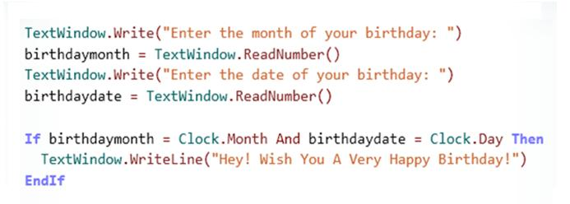
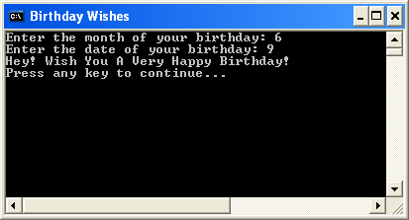
Month and Day
You can use the Month and the Day property of the Clock object to get the current month and current day, respectively.
How about writing a program that greets you on your birthday?
output
In this example, the text window displays birthday wishes only if user specifies the same month and day as the current system month and day.
Notes:
Code:
TextWindow.Write("Enter the month of your birthday:")
birthdaymonth = TextWindow.ReadNumber()
TextWindow.Write("Enter the date of your birthday:")
Birthdaydate = TextWindow.ReadNumber()
If (birthdaymonth = Clock.month And birthdaydate =Clock.Day) Then
TextWindow.WriteLine("Hey! Wish You A Very Happy Birthday!")
EndIf

Slide 7
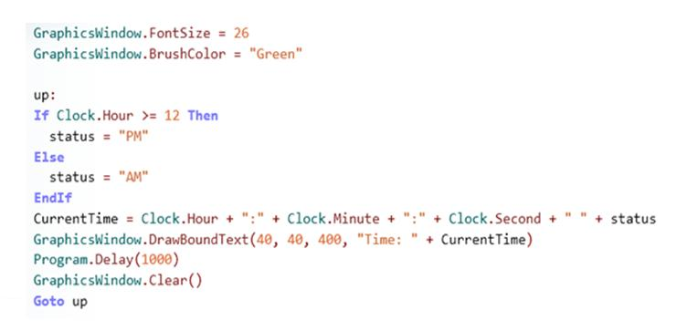
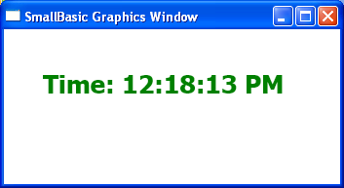
Hour, Minute, and Second
You can get the current hour, minute, and second of the day by using the Hour, Minute, and Second properties of the Clock object.
Let’s combine these properties to display a digital clock in the graphics window…
output
Notes:
In this example, we used the Hour, Minute, and Second properties of the Clock object to display a digital clock. We defined the clock status as PM if the current system hour is greater than or equal to 12; otherwise, the clock status is AM. To make the digital clock run continuously, we have used the Goto statement to jump to up: after 1000 milliseconds.
Code:
GraphicsWindow.FontSize = 26
GraphicsWindow.BrushColor = "Green"
up:
If Clock.Hour >= 12 Then
status = "PM"
Else
status = "AM"
EndIf
CurrentTime = Clock.Hour + " : " + Clock.Minute + " : " + Clock.Second + " " + status
GraphicsWindow.DrawBoundText(100, 100, 400, "Time: " + CurrentTime)
Program.Delay(1000)
GraphicsWindow.Clear()
Goto up

Slide 8
The Desktop Object
You can set a desktop wallpaper of your choice by using the the SetWallPaper operation of the Desktop object.
You can also retrieve the size of your current desktop and use the information to specify the location of objects on the screen.
When you use the SetWallPaper operation, you can choose your wallpaper image from any local file, network file, or Internet URL.
Notes:
Code:
ImagePath = Program.Directory + "\Blue.jpg"
Desktop.SetWallPaper(ImagePath)

Slide 9
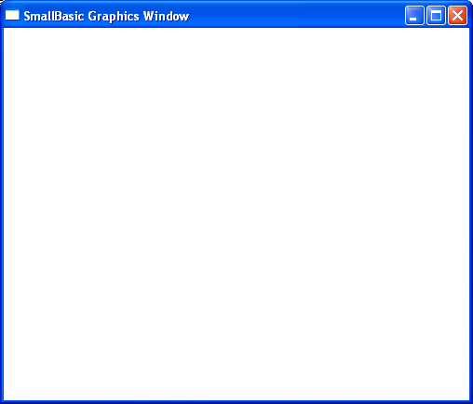
The Desktop Object
You can get the screen height and width of the primary desktop by using the Height and Width properties, respectively, of the Desktop object.
Let’s apply these properties to the graphics window.
output
Notes:
The Height and Width properties of the Desktop object are very useful when you want to display a text or graphics window in the same position relative to the top and left side of the desktop at various resolutions. In this example, the graphics window is 400 pixels high and 500 pixels wide. To display this window in the center of the desktop, subtract the window’s height and width from the height and width of the primary desktop, and then divide the results by 2.
Code:
GraphicsWindow.Height = 400
GraphicsWindow.Width = 500
GraphicsWindow.Top = (Desktop.Height - GraphicsWindow.Height) / 2
GraphicsWindow.Left = (Desktop.Width - GraphicsWindow.Width) / 2

Slide 10
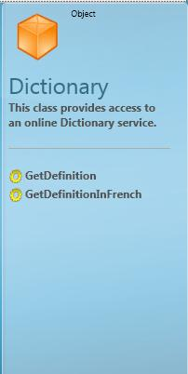
The Dictionary Object
The Dictionary object is a useful resource that you can include as part of your Small Basic program.
You can use this object to retrieve the meaning of a specified word from the online Dictionary service.
The Dictionary object has two operations—GetDefinition and GetDefinitionInFrench
Notes:
You must be connected to the Internet to use the Dictionary object in Small Basic.

Slide 11
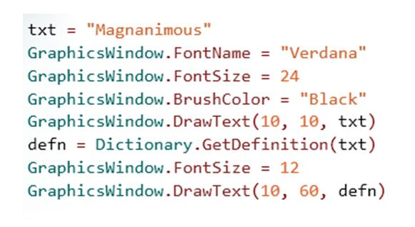
The Dictionary Object
You can obtain the meaning of an English word by using the GetDefinition operation. For a definition in French, use the GetDefinitionInFrench operation.
For example, let’s use the GetDefinition operation to find the meaning of “magnanimous.”
Notes:
Code:
txt = "Magnanimous"
GraphicsWindow.FontName = "verdana"
GraphicsWindow.FontSize = 24
GraphicsWindow.BrushColor = "Black"
GraphicsWindow.DrawText(10, 10, txt)
defn = Dictionary.GetDefinition(txt)
GraphicsWindow.FontSize = 12
GraphicsWindow.BrushColor = "Black"
GraphicsWindow.DrawText(10, 60, defn)

Slide 12
Let’s Summarize…
Congratulations! Now you know how to:
Use different properties of the Clock object.
Use different properties and operations of the Desktop object.
Use different operations of the Dictionary object.

Slide 13
Challenge 12: Alarm and Wallpaper.
Create a program to set an alarm that plays a sound of a ringing bell and changes the wallpaper of your desktop.
- Copy your code to a Word Document. Publish your app and paste the URL of your published app in the word document as well.
Essential Question(s):
How are system properties such as wallpaper and time accessed?

