Slide 1
Microsoft® Small Basic
Stacks and Arrays
Estimated time to complete this lesson: 1 hour

Slide 2
Stacks and Arrays
In this lesson, you will learn how to:
Use different operations of the Array object.
Use different operations of the Stack object.

Slide 3
Stacks and Arrays
Before we discuss the Array and Stack objects, let’s first understand when we might use either of these objects.
An array can have multiple dimensions, but a stack has only one dimension. You can directly access any element in an array, but you can access only the top element of a stack. In other words, you must go through all the elements of a stack to access its last element.

Slide 4
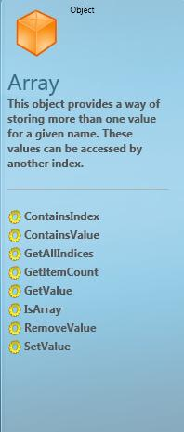
The Array Object
So far, you have learned about variables that store single values. Now, let’s learn about a special kind of variable that is called an array.
An array can store more than one value at the same time. If you want to store the names of five users, you can create five variables, or you can create just one variable to store all five names.
You use the indexing method to store multiple values in an array. For example, you can create an array called name as: name[1], name[2], name[3], name[4], and name[5]. Here, 1, 2, 3, 4, and 5 are the indices for the name array.
The name[1], name[2]… labels may appear to identify different variables, but they all represent just one variable!

Slide 5
Operations of the Array Object
Now, let’s discuss some operations of the Array object, such as
IsArray, ContainsIndex, and ContainsValue.
You can determine whether the specified variable is an array by using the IsArray operation.
You can determine whether an array contains the specified index if you use the ContainsIndex operation. This operation is helpful if you want to determine whether a specific value initializes the array’s index.
You can determine whether the array contains a value that you specify by using the ContainsValue operation. You can use this operation to determine whether the array’s value was stored in the index that you specify.
Notes:
If any of these operations succeeds, “TRUE” appears in the text window. Otherwise, “FALSE” appears.

Slide 6
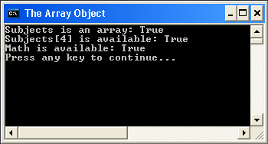
Operations of the Array Object
Let’s see how we can use these operations in a program.
In this example, the Subjects array stores the names of five subjects. You can verify whether Subjects is an array by using the IsArray operation. You can also verify whether the index Subjects[4] exists by using the ContainsIndex operation. You can verify whether the value “Math” exists in the Subjects array by using the ContainsValue operation.
output
Notes:
Code:
Subjects[1] = "English"
Subjects[2] = "History"
Subjects[3] = "Computers"
Subjects[4] = "Science"
Subjects[5] = "Math“
TextWindow.WriteLine("Subjects is an array: " + Array.IsArray(Subjects))
TextWindow.WriteLine("Subjects[4] is available: " + Array.ContainsIndex(Subjects, 4))
TextWindow.WriteLine("Math is available: " + Array.ContainsValue(Subjects, "Math"))
Array.GetItemCount(Subjects)

Slide 7
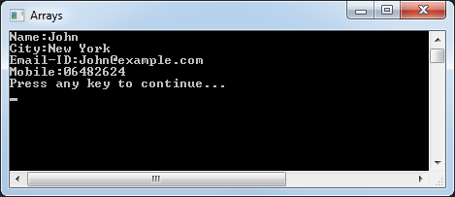
Operations of the Array Object
Look at this example to learn how to use these operations.
The Array object also provides more useful operations, such as:
GetAllIndices
GetItemCount
In this example, you don’t know the indices for the Employee array, so you use the GetAllIndices operation. Next, you use the GetItemCount operation in a For loop to list the information that is stored in the Employee array.
Notes:
You can use the GetAllIndices operation to get all the indices for the array, in the form of another array. This operation is especially useful when you don’t know the indices of an array. This operation displays an array along with all indices of the specified array. The index of the displayed array starts at 1.
You can use the GetItemCount operation to get the total number of items that are stored in the specified array. This operation displays the number of items in the specified array.
Code:
Employee["Name"] = "John"
Employee["City"] = "New York"
Employee["Email-ID"] = "John@example.com"
Employee["Mobile"] = "06482624"
Emplist = Array.GetAllIndices(Employee)
For i = 1 To Array.GetItemCount(Employee)
TextWindow.WriteLine(Emplist[i] + ":" + Employee[Emplist[i]])
EndFor

Slide 8
The Stack Object
You can use the Stack object to store data the same way as you stack plates. This object works on the principle of last-in, first-out (LIFO).
For example, if you look down at a stack of plates, you can see only the top plate. To see the next plate, you must remove this top plate. You can’t see a plate in the middle of the stack until you remove the plates above it.
The Stack object consists of three operations:
PushValue
PopValue
GetCount
Let’s explore each of these operations…

Slide 9
Operations of the Stack Object
The Stack object stores data just as a stack of plates. Let’s look at some examples to understand how this object works.
Using the PushValue operation is like adding a plate to the top of the stack. By using this operation, you can push a value to the stack that you specify.
Using the PopValue operation is like taking a plate from the top of the stack. You can use this operation to pop out a value from the stack that you specify.
The GetCount operation provides the total number of plates in the stack. You can use this operation to determine how many items a stack contains.
Notes:
The PushValue operation does not return anything.
The PopValue operation returns the value from the stack.
The GetCount operation returns the number of items in a specified stack.

Slide 10
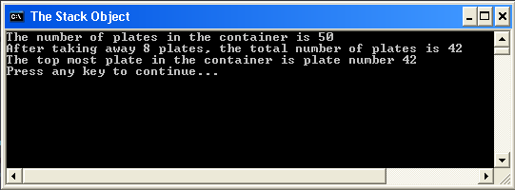
Operations of the Stack Object
Let’s write a program to better understand these operations.
In this example, you use the PushValue operation to push 50 plates into an empty container. Then you take eight plates from the stack by using the PopValue operation. Now, you use the GetCount operation to get the number of plates that remain. You also display the value of the top plate.
Notes:
Code:
container = "empty"
For i = 0 To 50
Stack.PushValue(container , "plate number " + i)
EndFor
TextWindow.WriteLine("The number of plates in the container is " + Stack.GetCount(container))
For i = 0 To 8
Stack.PopValue(container)
EndFor
TextWindow.WriteLine("After taking away 8 plates, the total number of plates is " + Stack.GetCount(container))
TextWindow.WriteLine("The top most plate in the container is " + Stack.PopValue(container))

Slide 11
Let’s Summarize…
Congratulations! Now you know how to:
Use different operations of the Stack object.
Use different operations of the Array object.

Slide 12
Mini Challenge 3.2:
By using the Array object, write a flight-reservation program that you can use to perform the following actions:
Use a “For” Loop in combination with an array to reserve seats for 10 passengers.
Show how many seats are still available.
Display each passenger’s name and seat number.
Question:
1. What advantages does an array have in storing variables over just using regular variable declarations?

