Slide 1
Microsoft® Small Basic
Events and Interactivity
Estimated time to complete this lesson: 1 hour

Slide 2
Events and Interactivity
In this lesson, you will learn how to:
Use keyboard events in your program.
Use mouse events in your program.

Slide 3
Introduction to Events
This lesson introduces you to events with which you can add interactivity to your Small Basic programs.
In other words, you can create an interactive program in Small Basic by defining events that trigger an action in response to user inputs.
Interactivity here includes events that trigger an action; for instance, when the user clicks a button on the mouse or presses a key on the keyboard.

Slide 4
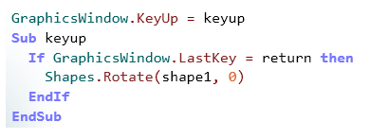
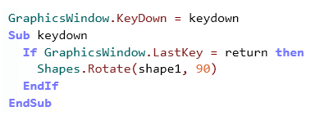
Keyboard Events
Keyboard events produce an action when the user presses or releases a certain key. There are two keyboard events—KeyDown and KeyUp. These events are defined as operations of the GraphicsWindow object.
KeyUp raises an event when the user releases a key on the keyboard.
KeyDown raises an event when the user presses a key on the keyboard.
Notes:
Code:
Sub keyup
If GraphicsWindow.LastKey = return then
Shapes.Rotate(shape1, 0)
EndIf
EndSub
Sub keydown
If GraphicsWindow.LastKey = return then
Shapes.Rotate(shape1, 90)
EndIf
EndSub

Slide 5
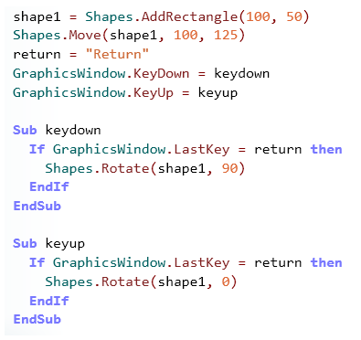
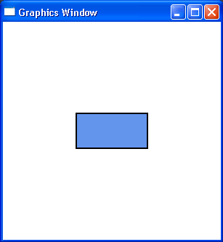
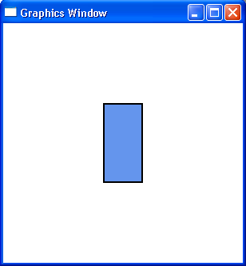
Keyboard Events
Let’s demonstrate keyboard events in Small Basic with a simple program that rotates a shape in the graphics window when you press a key on the keyboard.
In this example, you press RETURN to rotate a rectangle shape in the graphics window. When you release the key, the rectangle returns to its original state.
Notes:
In the editor window, you add the rectangle by using the AddRectangle operation of the Shapes object.
You set the location of the rectangle by using the Move operation.
You identify the key with which the rectangle can be rotated. You declare the key and assign it a suitable variable name.
You use the KeyDown event of the GraphicsWindow object and declare a subroutine to rotate the shape when the user presses the key.
Similarly, you use the KeyUp event and declare a subroutine to rotate the shape when the user releases the key.
When you click Run on the toolbar, your program runs. A graphics window appears with a rectangle in the center. When you press RETURN, the rectangle rotates. When you release the Return key, the rectangle rotates back to its original position.
Code:
GraphicsWindow.Height = 300
GraphicsWindow.Width = 300
GraphicsWindow.Title = "Graphics Window"
shape1 = Shapes.AddRectangle(100, 50)
Shapes.Move(shape1, 100, 125)
return = "Return"
GraphicsWindow.KeyDown = keydown
GraphicsWindow.KeyUp = keyup
Sub keydown
If GraphicsWindow.LastKey = return then
Shapes.Rotate(shape1, 90)
EndIf
EndSub
Sub keyup
If GraphicsWindow.LastKey = return then
Shapes.Rotate(shape1, 0)
EndIf
EndSub

Slide 6
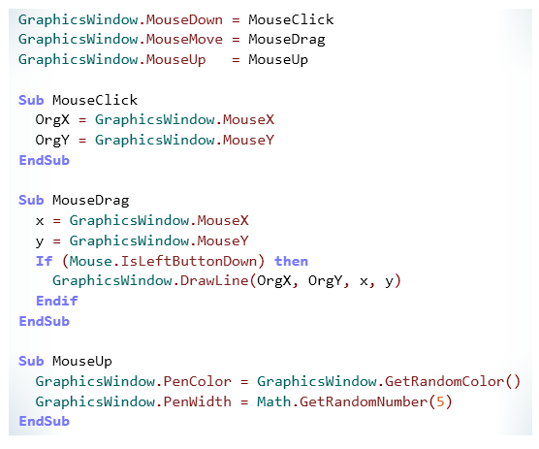
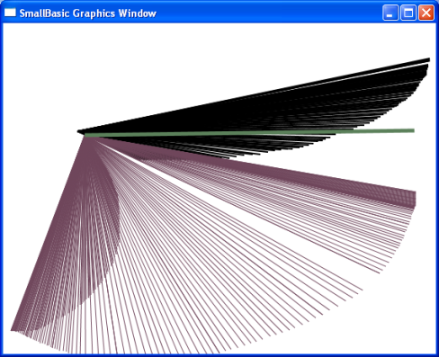
Mouse Events
As you did with keyboard events, you can create programs in Small Basic that work with events that are based on mouse clicks. Mouse events generate actions in your program when the user clicks a mouse button.
Let’s see how we can use these events in a program.
MouseDown raises an event when the user clicks a mouse button.
MouseUp raises an event when the user releases a mouse button.
MouseMove raises an event when the user moves the mouse pointer in the graphics window.
Notes:
You must declare the mouse events in your code. Small Basic has three types of mouse events: MouseDown, MouseUp, and MouseMove. You must also assign an accompanying subroutine for your event. When the mouse is clicked, released, or moved, the subroutine will perform the action that is defined within it. You can use mouse events on controls and shapes.
Code:
GraphicsWindow.MouseDown = MouseClick
GraphicsWindow.MouseMove = MouseDrag
GraphicsWindow.MouseUp = MouseUp
Sub MouseClick
OrgX = GraphicsWindow.MouseX
OrgY = GraphicsWindow.MouseY
EndSub
Sub MouseDrag
x = GraphicsWindow.MouseX
y = GraphicsWindow.MouseY
If (Mouse.IsLeftButtonDown) then
GraphicsWindow.DrawLine(OrgX, OrgY, x, y)
Endif
EndSub
Sub MouseUp
GraphicsWindow.PenColor=GraphicsWindow.GetRandomColor()
GraphicsWindow.PenWidth=Math.GetRandomNumber(5)
EndSub

Slide 7
Let’s Summarize…
Congratulations! Now you know how to:
Use keyboard events in your program.
Using mouse events in your program.

Slide 8
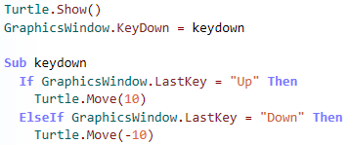
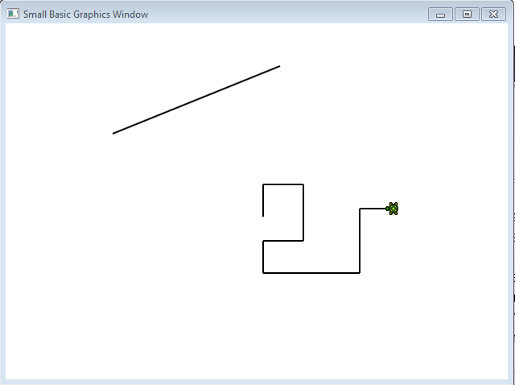
Mini Challenge 3.4
Write a program to demonstrate mouse events and keyboard events by performing the following steps:
Create a user interface by using the GraphicsWindow object.
Create MouseUp and MouseDown Events and attach them to Separate Subroutines that following the MouseUp Event Draws a line from the point of Mouse Down to the Point of Mouse Up.
Show a Turtle. Make a KeyDown event that attaches to a subroutine that with a series of “If…Then…ElseIf” statements moves the Turtle forward when “Up” is pressed, back when “Down” is pressed and turns left when “Left” is pressed and right when “Right” is pressed (You may need to review Lesson 2.2 Turtle Graphics).

