Slide 1
Microsoft® Small Basic
The Controls Object
Estimated time to complete this lesson: 1 hour

Slide 2
The Controls Object
In this lesson, you will learn how to:
Use various properties of the Controls object.
Use various operations of the Controls object.
Use control events on buttons and text boxes in your program.

Slide 3
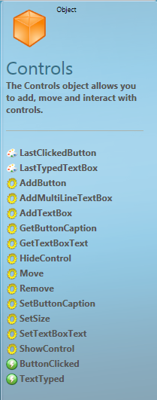
Introduction to the Controls Object
So far, you have learned to use different objects in Small Basic, such as the GraphicsWindow and Shapes objects.
This lesson introduces you to the Controls object that Small Basic offers. By using this object, you can display simple controls, such as text boxes and buttons, in the graphics window.

Slide 4
Operations of the Controls Object
Before we create a program by using the Controls object, let’s learn about some operations of the Controls object and their parameters.
AddTextBox—You can define a text box that will appear in the graphics window by using this operation. As parameters, you must specify the text box’s x-coordinate and
y-coordinate.
AddButton—You can define a button that will appear in the graphics window by using this operation. As parameters, you must specify the button’s caption and its x-coordinate and y-coordinate.
Notes:
Code:
textbox = Controls.AddTextBox(200, 150)
button = Controls.AddButton("Button", 150, 200)

Slide 5
Operations of the Controls Object
GetButtonCaption—By using this operation, you can retrieve the caption of a button. You must specify the name of the button as a parameter.
SetButtonCaption—By using this operation, you can set or change the caption of a button. You must specify the name of the button and the new caption as parameters.
GetTextBoxText—You can retrieve the text that appears in a text box by specifying its name as a parameter for this operation.
SetTextBoxText—You can define the text to appear in a text box by specifying its name and the required text as parameters for this operation.
Notes:
Code:
Controls.GetButtonCaption(button)
Controls.SetButtonCaption(button, "Click")
Controls.GetTextBoxText(textbox)
Controls.SetTextBoxText(textbox, "Hello World!")

Slide 6
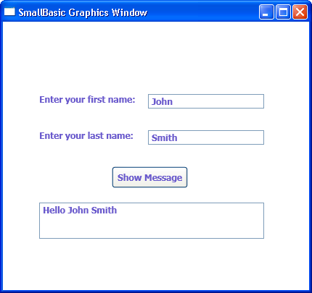
Operations of the Controls Object
In addition to adding useful controls into your program, you can perform certain operations and define the settings for the controls that you add.
Let’s explore the Controls object with the help of an example.
Notes:
You can add controls onto the screen by typing a statement that contains an operation of the Controls object. Look at the example on the screen:
First, you use the AddTextBox operation of the Controls object to add text boxes that accept the first and last name of the user. You must specify the x-coordinates and y-coordinates of the text boxes as parameters.
Next, you use the AddButton operation to add a button onto the graphics window. In addition to the button’s x-coordinate and y-coordinate, you must also specify the button’s caption as a parameter.
Next, you use the AddMultiLineTextBox operation to add another text box. You must specify the x-coordinate and y-coordinate of the text box as parameters.
In this example, you want to display a message in the multiline text box when the user clicks Show Message. So you use the ButtonClicked event and create a subroutine for displaying a message in the multiline text box.
Check the output of your program by clicking Run on the toolbar or pressing F5 on the keyboard.
Code:
GraphicsWindow.DrawText(50, 100, "Enter your first name:")
firstname = Controls.AddTextBox(200, 100)
GraphicsWindow.DrawText(50, 150, "Enter your last name:")
lastname = Controls.AddTextBox(200, 150)
showbutton = Controls.AddButton("Show Message", 150, 200)
message = Controls.AddMultiLineTextBox(50, 250)
Controls.SetSize(message, 310, 50)
Controls.ButtonClicked = ShowMessage
Sub ShowMessage
If Controls.GetButtonCaption(showbutton) = "Show Message" Then
Controls.SetTextBoxText(message,"Hello " + Controls.GetTextBoxText(firstname) + " " + Controls.GetTextBoxText(lastname))
EndIf
EndSub

Slide 7
Properties and Operations of the Controls object
Let’s look at the capabilities that a few more operations and properties of the Controls object offer.
HideControl—You can use this operation to hide an existing control from the graphics window.
ShowControl—You can use this operation to display a previously hidden control in the graphics window.
Remove—You can use this operation to remove a control from the graphics window.
Notes:
Code:
Controls.HideControl(textbox)
Controls.ShowControl(button)
Controls.Remove(textbox)

Slide 8
Properties and Operations of the Controls object
SetSize—You can specify a fixed size for a control by using this operation. You must specify the name, height, and width of the control as parameters.
Move—You can move a control to a different position in the graphics window by using this operation. You must specify the name, left coordinate, and top coordinate of the control as parameters.
LastClickedButton—You can use this operation to find the last button that was clicked on the graphics window.
LastTypedTextBox—You can use this operation to find the last text box where text was typed.
Notes:
Code:
Controls.SetSize(textbox, 300, 50)
Controls.Move(textbox, 100, 150)
Controls.LastClickedButton
Controls.LastTypedTextBox

Slide 9
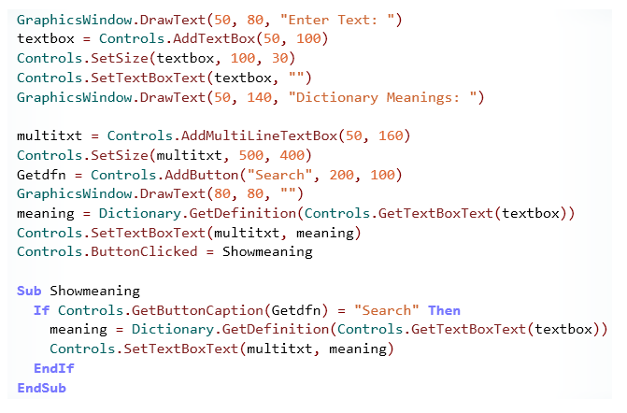
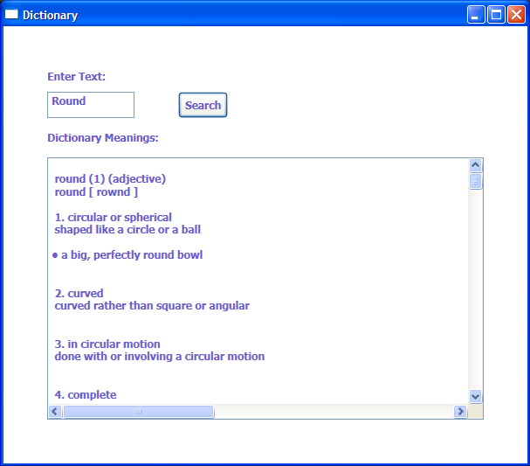
The Controls Object
Now let’s write a simple program that includes the Controls object. This program displays the definitions of a given word.
output
Notes:
You can create simple programs in Small Basic by using controls such as text boxes and buttons. For example, look at the program displayed. In this program, we write code to display two text boxes and a Search button. In the first text box, the user enters a word. When the user clicks Search, the definition of the word appears in the second, multiline text box. We use the Dictionary object to display the meaning of the word in the multiline text box.
Code:
GraphicsWindow.Title = "Dictionary"
GraphicsWindow.Height = 600
GraphicsWindow.Width = 600
GraphicsWindow.DrawText(50, 80, "Enter Text: ")
textbox = Controls.AddTextBox(50, 100)
Controls.SetSize(textbox, 100, 30)
Controls.SetTextBoxText(textbox, "")
GraphicsWindow.DrawText(50, 140, "Dictionary Meanings: ")
multitxt = Controls.AddMultiLineTextBox(50, 160)
Controls.SetSize(multitxt, 500, 400)
Getdfn = Controls.AddButton("Search", 200, 100)
GraphicsWindow.DrawText(80, 80, "")
meaning = Dictionary.GetDefinition(Controls.GetTextBoxText(textbox))
Controls.SetTextBoxText(multitxt, meaning)
Controls.ButtonClicked = Showmeaning
Sub Showmeaning
If Controls.GetButtonCaption(Getdfn) = "Search" Then
meaning = Dictionary.GetDefinition(Controls.GetTextBoxText(textbox))
Controls.SetTextBoxText(multitxt, meaning)
EndIf
EndSub

Slide 10
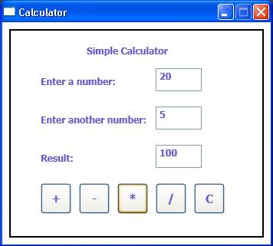
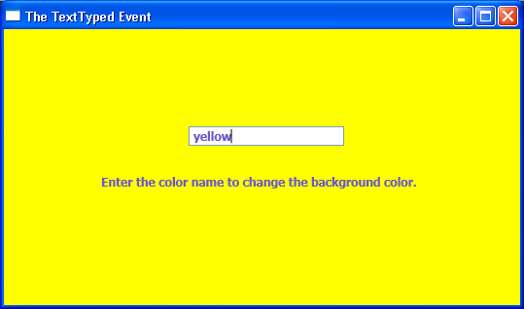
Control Events
Now that you are familiar with the Controls object in Small Basic, let’s get acquainted with the events that you can use for that object. Control events can generate actions in your program when the user clicks a button or types some text into a text box.
ButtonClicked raises an event when the user clicks a button.
TextTyped raises an event when the user types text into a text box.
You can use the ButtonClicked event to make a simple calculator like the one that appears to the right:
And here’s an example of the TextTyped event:
Notes:
Now let’s demonstrate the concept of control events with an example of the calculator. You can create a simple calculator in Small Basic by using the TextBox control, the Button control, and the ButtonClicked event. The user can enter two numbers in the calculator and display results of addition, subtraction, multiplication, and division.
In the editor window, you first create the user interface by using the GraphicsWindow object and then you insert the text boxes and buttons by using the Controls object. Next, you use the ButtonClicked event and a subroutine that contains the actions that will generate the sum, difference, multiplication, and quotient of the two numbers.
When you click Run on the toolbar, your program runs. The graphics window displays three text boxes: two for number inputs and one for the result. When the user clicks a button, the corresponding result appears in the result text box. The calculator also contains a button to clear text from all text boxes.
Code:
w = 350
h = 290
GraphicsWindow.CanResize = "False"
GraphicsWindow.Width = w
GraphicsWindow.Height = h
GraphicsWindow.Top = (Desktop.Height-h) / 2
GraphicsWindow.Left = (Desktop.Width-w) / 2
GraphicsWindow.Title = "Calculator"
CreateGUI()
Controls.ButtonClicked = ButtonDown
Sub CreateGUI
GraphicsWindow.DrawRectangle(10, 10, 330, 270)
GraphicsWindow.DrawText(50, 70, "Enter first Number: ")
Ftextbox = Controls.AddTextBox(200, 60)
Controls.SetSize(Ftextbox, 60, 30)
GraphicsWindow.DrawText(50, 120, "Enter Second Number: ")
Stextbox = Controls.AddTextBox(200, 110)
Controls.SetSize(Stextbox, 60, 30)
GraphicsWindow.DrawText(50, 170,"Answer is:")
Atextbox=Controls.AddTextBox(200, 160)
Controls.SetSize(Atextbox, 60, 30)
GraphicsWindow.FontSize = 15
Plus = Controls.AddButton("+", 20, 210)
Controls.SetSize(Plus, 40, 40)
Minus = Controls.AddButton("-", 70, 210)
Controls.SetSize(Minus, 40, 40)
Asterisk = Controls.AddButton("*", 120, 210)
Controls.SetSize(Asterisk, 40, 40)
Division = Controls.AddButton("/", 170, 210)
Controls.SetSize(Division, 40, 40)
Clear = Controls.AddButton("C", 220, 210)
Controls.SetSize(Clear, 40, 40)
EndSub
Sub ButtonDown
FtxtValue = controls.GetTextBoxText(Ftextbox)
StxtValue = controls.GetTextBoxText(Stextbox)
operator = Controls.GetButtonCaption(Controls.LastClickedButton)
If operator = "C" Then
Controls.SetTextBoxText(Ftextbox, "")
Controls.SetTextBoxText(Stextbox, "")
Controls.SetTextBoxText(Atextbox, "")
ElseIf operator = "+" Then
AtxtValue = FtxtValue + StxtValue
Controls.SetTextBoxText(Atextbox, AtxtValue)
ElseIf operator = "-" Then
AtxtValue = FtxtValue - StxtValue
Controls.SetTextBoxText(Atextbox, AtxtValue)
ElseIf operator = "*" Then
AtxtValue=FtxtValue*StxtValue
Controls.SetTextBoxText(Atextbox,AtxtValue)
Else
AtxtValue=FtxtValue/StxtValue
Controls.SetTextBoxText(Atextbox,AtxtValue)
EndIf
EndSub

Slide 11
Let’s Summarize…
Congratulations! Now you know how to:
Use various properties of the Controls object.
Use various operations of the Controls object.
Use control events on buttons and text boxes in your program.

Slide 12
Mini Challenge 3.5: Forms
Write a program to display a simple form, and perform the following steps:
Add text boxes to request the name, address, telephone number, and e-mail address of the user.
Add a Submit button to the form.
After the user specifies the information and clicks Submit, display the users information in a message.
Use the snipping tool to save and hand in
your code and output.

