Slide 1
COURSE CSE1220: CLIENT-SIDE SCRIPTING 2
Level: Introductory
Prerequisite: None
Note: CSE1210: Client-side Scripting 1 or an equivalent course dealing with markup scripting is strongly recommended
Students deepen their understanding of Internet computing by using more
advanced markup language techniques and by being introduced to one or more
Web-specific scripting languages. As part of this process, students learn how
the Web uses these resources as a means of displaying dynamic client-side
information. Students learn how to analyze, modify, write and debug
algorithms and scripts that use structured programming approaches.

Slide 2
Assignment #1: Dynamic Vs. Static Websites
In a word document or PowerPoint research the difference between static and dynamic websites. Your document should include:
Compare and contrast static and dynamic client-side scripting
Describe and illustrate the main differences, from the user's perspective, between dynamic and static client-side Web sites.
Describe and illustrate the main differences between how dynamic and static client-side sites are implemented by the Web.
b)describe and illustrate the main advantages and disadvantages of dynamic and static client-side sites.

Slide 3
Style Sheet Tutorial
Complete the following CSS tutorial:
Create an new folder called “yourlastnameYourFirstName2”.
Complete the following tutorial. Every file created in the tutorial below needs to be placed in the folder created above.
https://www.youtube.com/watch?v=0afZj1G0BIE

Slide 4
Assignment #2: Style Sheets
Using your knowledge of style sheets. Modify or create a new website that uses CSS to add style and formatting to your site. Your site cannot be identical to the tutorial. Make your own unique styled page.

Slide 5
JavaScript Tutorial
Create a folder in a location of your choice named “yourlastnameYourfirstname3”.
Search the internet for a jpg image of a cat and dog. Download the image to the folder you created and name it “catdog.jpg”
Create a html file in notepad++ and save it to the folder. Name it index.html.
Add the code on the following page. With your previous programming knowledge look at the code and try to interpret what is going on.
Open the index.html file with a webbrowser(double clicking will likely open it in your default browser).

Slide 6
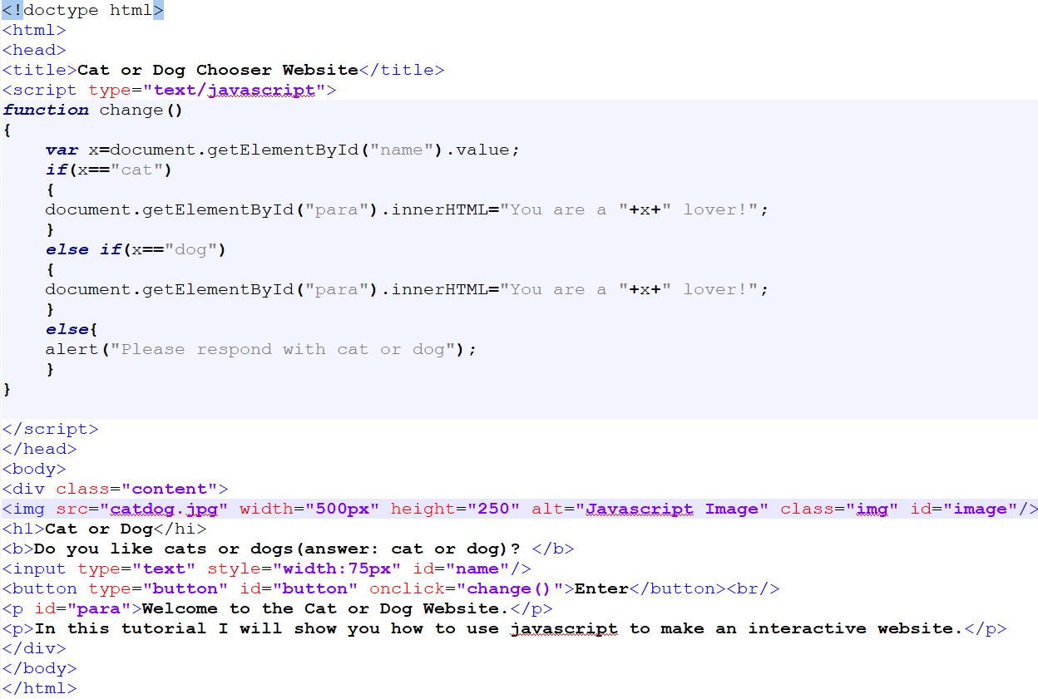
Code Example:

Slide 7
Assignment #3: Javascript
Create a new website or modify the preceding tutorial to make an interactive webpage using javascript. Your example must use different images, text etc. and must respond to user input. Your example must take input from a minimum of 2 textboxes and make at least one decision based on user input.

