Slide 1
CSE2120: DATA STRUCTURES 1
Prerequisite: CSE2110: Procedural Programming 1

Slide 2
Data Structures 1: Eclipse and Android Studio – Java and SQLite
Description: Students learn how to design code and debug programs that use a set of data structures that can be used to handle lists of related data. Building on their knowledge of basic or primitive data types, they learn how to work with fundamental data structures such as the array and the record. As part of this process, they learn what types of problems benefit from the use of these types of data structures.

Slide 3
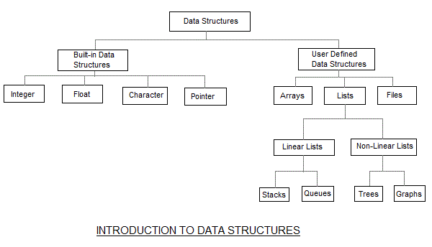
Data Structures
Built-in Data Structures “(Primitive types) are the most basic data types available within the Java language. There are 8: boolean , byte , char , short , int , long , float and double . These typesserve as the building blocks of data manipulation in Java. Such types serve only one purpose — containing pure, simple values of a kind.”(https://www.studytonight.com/data-structures/introduction-to-data-structures).
User Defined Data Structures are data structure types that help us better organize, sort and index data. See the following diagram below.

Slide 4
Assignments #1: Why Arrays?
Review the following videos from Computer Science 1:
Assignment Video Tutorial- Part B(1)
Assignment Video Tutorial- Part B(2)
In a word document explain the benefit of using user defined data types over built in data types to store large amounts of data.

Slide 5
Assignment #2: Number Sorter
Using your knowledge from the videos from Assignment #1, create a number sorter. Given a random set of 10 positive numbers stored in array. Iterate through the array and pull out the highest number one by one until they are reordered from highest to lowest and stored in a new array.
Complete this assignment in Eclipse.
Save a screenshot of your code to the hand in folder.

Slide 6
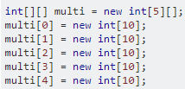
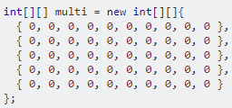
Multi Dimensional Arrays
Often times we need to store table data in code. The best method to do this could be a multi-dimensional array. With a multidimensional array we are basically using a coordinate system with the first member of the multidimensional array being [0] [0]. The following 3 code snippets demonstrate 3 identical ways of declaring multi-dimensional arrays:

Slide 7
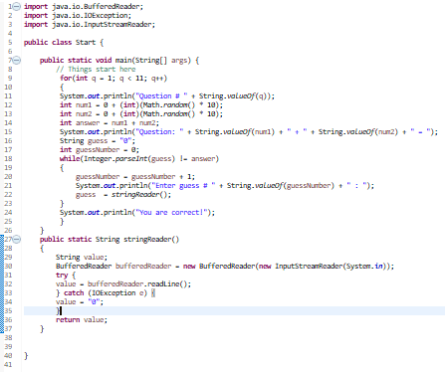
Receiving Console Input Java
The following code is a simple Math Game that asks 10 addition questions and moves to the next question when a correct answer is given. At the bottom of this section of code there is a function that allows console input in java. You will need to use this function in the following assignment. You will also need to use looping in a similar way to complete the assignment on the next slide. Review the code below and make sure you understand it.

Slide 8
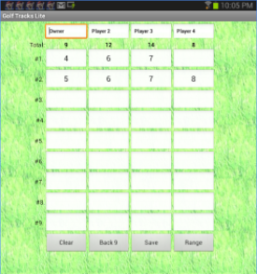
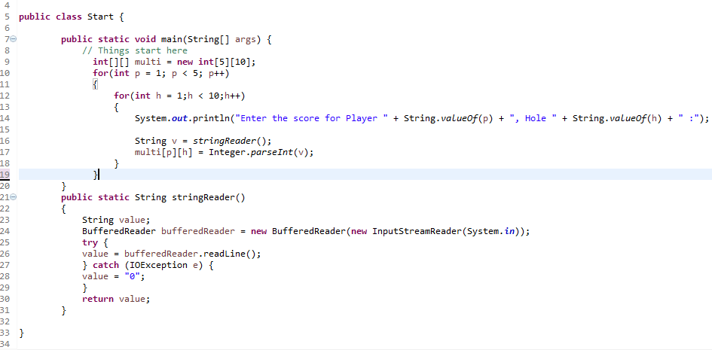
Assignment #3 : Golf Score Tracker
Create a golf score tracker in eclipse that calculates the scores of 4 golfers for 9 holes of golf. The following snippet shows how to take in users scores and store them in a multidimensional array. To complete the project add to the code that calculates and displays each golfers individual scores.

Slide 9
SQLite Intro
Install Android Studio via System Center or download.
Complete the following tutorial as an intro to SQLite on Android.
https://youtu.be/La_lmhYOA2Y
Other Resources:
https://www.youtube.com/watch?v=cp2rL3sAFmI
https://www.youtube.com/watch?v=p8TaTgr4uKM
https://www.youtube.com/watch?v=T0ClYrJukPA
https://www.youtube.com/watch?v=KUq5wf3Mh0c
https://www.youtube.com/watch?v=PA4A9IesyCg
https://www.youtube.com/watch?v=neaCUaHa2Ek

Slide 10
Assignment #4: Database App
Create an app that uses a database to store and display data in some meaningful way. Use the information from the videos on the previous slides to create a database in the project.
Hand in your entire project into the hand in folder. If you wish to generate an .apk file and/or submit an app to the Play Store talk to your teacher for guidance.

