Slide 1
COURSE CSE2140: SECOND LANGUAGE PROGRAMMING 1
Prerequisite: CSE2110: Procedural Programming 1 or
CSE1120: Structured Programming 2
Note: This course has been developed with the expectation that students have previously completed Structured Programming 1(using Lua as the programming language) and Structured Programming 2 (using C# as the programming language)

Slide 2
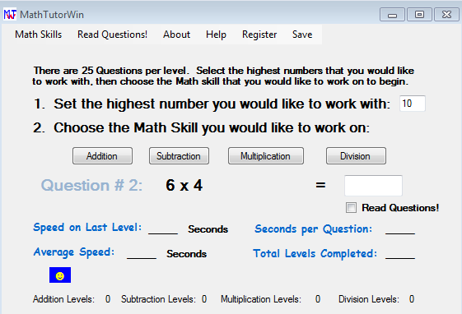
Assignment #1: Math Wizard C#
Create a windows forms app that helps children work on basic addition, subtraction, multiplication and division. The children should be able to select the math skill they would like to work on and then answer 10 questions of that type. Students should not be able to move on to the next question until the previous question is completed. The user interface should look similar to the one to the right. Bonus marks for adding a timer that determines the speed per level and question.
You may need to review the following videos as a basic overview of setting up the UI and adding event handlers in Visual Studio:
https://www.youtube.com/watch?v=1omSlGv1oU8
https://www.youtube.com/watch?v=Vx45TfpmCT0
Programming the logic is up to you.

Slide 3
Assignment #2: Math Wizard Lua
Create a mobile app with Lua in Corona that helps children work on basic addition, subtraction, multiplication and division. The children should be able to select the math skill they would like to work on and then answer 10 questions of that type. Students should not be able to move on to the next question until the previous question is completed. The user interface should look similar windows forms app. Add all of the feature you added to assignment #1 to this app. The following slides should serve as reminder as of how to add the different UI elements for this project. The logic is up to you.

Slide 4
Text Box and Event Handler in Lua
Note: Textboxes are native fields and currently will not be functional in the emulator. After the UI is designed the textboxes will need to be tested on an actual android device by deploying an .apk file to an actual device.

Slide 5
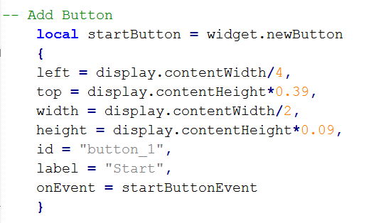
Button and Handler in Lua

Slide 6
Lua Textfields

Slide 7
Radio Buttons in Lua

Slide 8
Assignment #3: Language Comparison Assignment
In a 1 – 2 page essay, compare and contrast C# and Lua. Use the following points as a guideline:
1.1 consider the programming paradigms supported by each language including:
1.1.1 naming the paradigms supported
1.1.2 outlining the relative advantages and disadvantages of the paradigms
1.2 consider the source code to machine code translation process used by each language by:
1.2.1 identifying and describing the process used by each language
1.2.2 outlining the relative advantages and disadvantages of each language
1.3 consider the language characteristics including:
1.3.1 language level; e.g., low, high, very high
1.3.2 level of type; e.g., strongly typed, weakly typed
1.3.3 nature of the source code; e.g., iconic, widgets, graphical
1.3.4 difficulty to construct source code; e.g., attendant learning curve
1.3.5 programming resources and aids
1.4 consider the modular characteristics of each language including:
1.4.1 types of subprograms supported
1.4.2 how modularity is supported
1.4.3 level of module cohesion possible
1.4.4 amount of module coupling required

