Slide 1
COURSE CSE2240: ROBOTICS PROGRAMMING 2
Prerequisite:
CSE1240: Robotics Programming 1
CSE1120: Structured Programming 2

Slide 2
Description
Students add to their understanding of robotics programming by employing
procedural programming techniques and fundamental data structures to create
programs that display greater agency and autonomy. They learn how to
analyze, modify, write and debug robotics algorithms and programs in which
modularity is achieved through subprograms such as functions and
fundamental data structures such as arrays.

Slide 3
Where We Left Off…
In Robotics Programming 1 we competed several assignments that gave us a basic understanding of programming robots ending off with a basic robot program that included a drive train and a wrist. In Robotics Programming 2 we will extend our code to add more subsystems and autonomous code. We will also investigate the benefits of using Command Based Programming(OOP) vs. the Iterative Model in FRC.

Slide 4
Assignment #1: Iterative vs. Command Based Robot Model
Use the following links to investigate the benefits of using an iterative model or command based model for programming robots. Be specific in describing which model makes programming autonomous easier and which model makes managing complex subsystems easier.
Simple, Iterative or Command Based
Iterative or Command Based

Slide 5
Assignment #2: Sensors for AI
Being able to take in input from the environment, learn from the input and then respond to the input is the basis of Artificial Intelligence(AI).
Task:
In this assignment, we will once again use an Arduino to explore how data from a sensor can be processed to output meaningful information to the user. Using an Arduino and a PWM shield connect a rangefinder properly. I have provided the code to log rangefinder outputs in the folder “Rangefinder” within this folder. Your task is to create a loop that checks the range every 2 seconds for a total of 20 seconds(10 loops). After 20 seconds you will display to the user in the log or in a LED display the distance to the object in front of the rangefinder in a statement like “The average distance was: ????”. To test your code move an object to different distances while the rangefinder is running for 20 seconds.
Bonus: Along with adding a LED display also add the Joystick Button Press(Joysticks have a digital button) that initiates the distance check.
* Record your project in a video and hand it in to the hand in folder.

Slide 6
Assignment #3: Complete Robot
Part A: Our robot for the 2016 FRC season consisted of 4 subsystems:
Drivetrain
Wrist
Shooter
KickerLeg
Using your project from Robotics Programming 1, extend your code and add the additional Shooter and KickerLeg subsystems(which work together to shoot) to make a complete working robot. See the next slide for the information needed to complete this step.

Slide 7
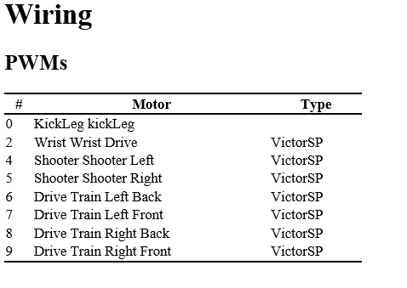
This video was the base of your code from Robotics Programming 1. Continue to refer to it as guide to work with Robot Builder and Eclipse.
Robotbuilder + Eclipse Tutorial - https://youtu.be/ef-jqacGUFU
Use this video series to provide any missing information from the above video(Note: These videos were filmed in the NetBeans IDE so you may still need to refer to the video above for Eclipse specific info.
Robot Builder Playlist - https://www.youtube.com/watch?v=k7PaYcjDEDc&list=PLYA9eZLlgz7t9Oleid2wtlgnvhGObeKzp

Slide 8
Assignment #4: Autonomous
Now that you have the command based system in place, programming autonomous is easy. Use the end of the videos on the previous slide to make a command group autonomous code that does the following:
Drives forward for 2 seconds or until a distance of 20cm(If a rangefinder is available use the sample code in this folder, “Drivetrain with Rangefinder”, to add a rangefinder).
Lifts the shooter.
Shoots
Drives back 2 seconds or to 100cm

Slide 9
Wrapping Things up
Go through your code and comment your code explaining what is happening in different parts of your code. Deploy your code and demonstrate to your teacher that both the User controlled code and Autonomous code work. Hand in your project folder so that assignments 2 and 3 can be marked.

