Slide 1
CSE3110: ITERATIVE ALGORITHM 1
Prerequisite: CSE2120: Data Structures 1

Slide 2
Algorithms to organize data
In computer science we often need to organize data for use within applications. There are three categories of algorithms that are commonly used in many programming languages to organize data. The three categories of commonly used algorithms are Search, Sort and Merge algorithms. There are several ways we can go about accomplishing these tasks. In this module we will look at several different ways that we can Search, Sort and Merge data. For the sake of this module we will be sorting data stored in arrays.

Slide 3
Sort:
We often need to sort number values for use within programs. Efficiency of code is important so finding the right sorting method is important for application performance. The following 5 slides show 5 different sorting methods.
Assignment #1: Part A
In Eclipse create 5 Java Projects named “Exchange”, “Bubble”, “Gnome”, “Selection” and “Insertion”. Copy the code from the 5 following slides into each of these projects. These projects contain code to log to the console. All five projects sort the same integer array of data from smallest to largest. Screenshot the 5 console logs produced by your code. Paste the logs into a word document. Examine the console logs to see how the array is sorted by the three different methods. In a short paragraph below the screenshots, compare and contrast the 5 sorting methods. Identify which method you think is the most efficient. You may wish to change the length of the arrays(keep them the same for all 5 when testing), to see if efficiency of each of the sort methods changes with array length.

Slide 4
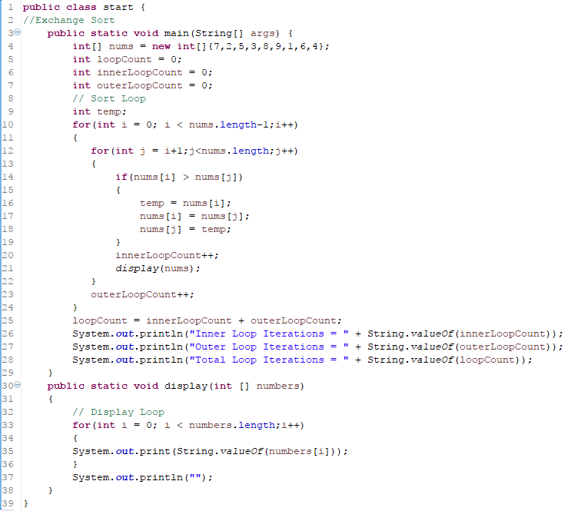
Exchange Sort:

Slide 5
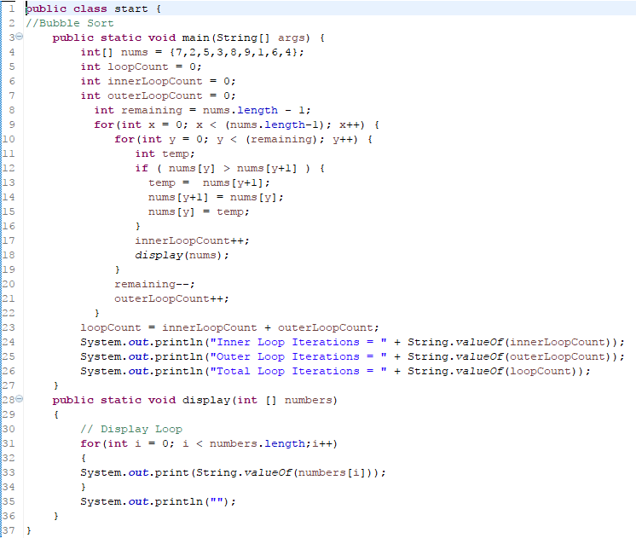
Bubble Sort:

Slide 6
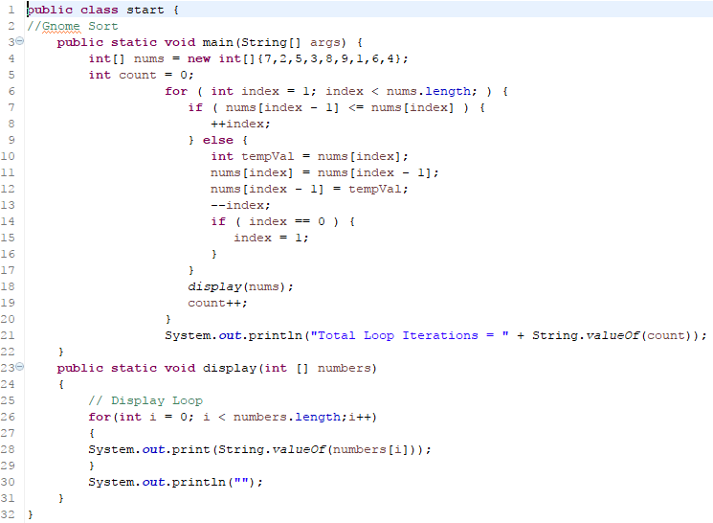
Gnome Sort:

Slide 7
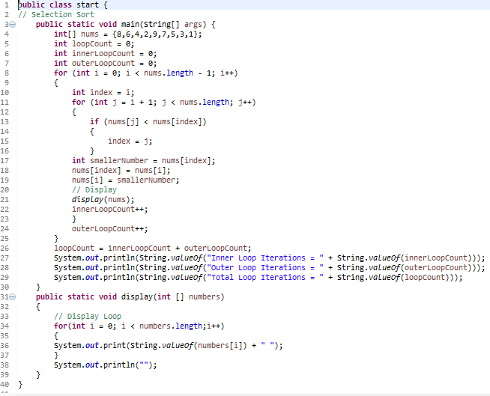
Selection Sort:

Slide 8
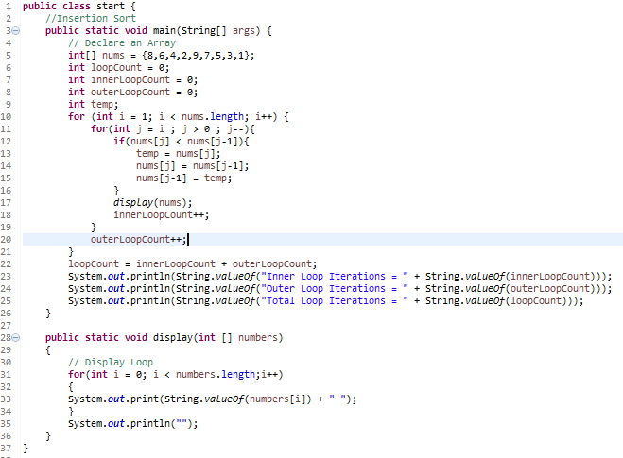
Insertion Sort:

Slide 9
Assignment #1: Part B
Using one of the sort methods from the previous slides, create a java program that sorts an array of numbers from largest to smallest.
Assignment #1: Part C
Building on one of the sort methods from the previous slides, create a java program that finds the median number from a set of integer arrays. If the array length is an even number average the two median numbers to produce your result.

Slide 10
Search:
Two common types of searches that we use in computer science are binary and linear searches. Watch the following video comparison of the two types of searches.
https://www.youtube.com/watch?v=wNVCJj642n4
Assignment #2:
In your programming language of choice, create an example of a linear search that iterates through an integer array and finds a “key” value.
* Snippet your code and the results and save them to a word document.
b) In your programming language of choice, create an example of a binary search that iterates through an integer array and finds a “key” value.
Snippet your code and the results and save them to a word document.
In a short paragraph or a T – table compare and contrast a binary search with a linear search. Some guiding questions may be: Which one search method is faster on average? What is the requirement does a binary search have that a linear search does not have?
* Hand in your word document with parts a, b and c to the hand in folder.

Slide 11
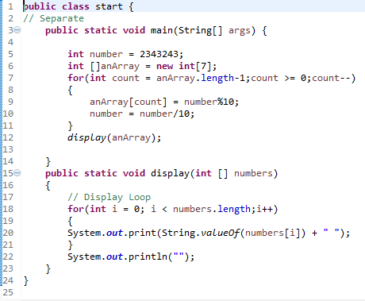
Separate:
Occasionally we are given variables in a format that we may need to separate out into individual characters. In the following example we are given an integer that we need to convert into an integer array. Inside the loop we collect the remainder of dividing by 10(% operator) and then divide by 10 to remove the last digit of the number.

Slide 12
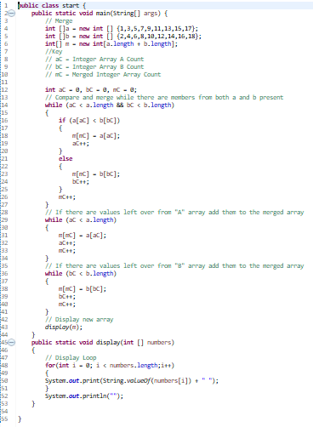
Merge:
Sometimes in code we need to merge multiple pieces of data. The code on the following slide merges two sorted integer arrays. It will merge any two arrays of any size but the pre-requirement is that the arrays are sorted prior to being merged. Review the code on the following slide as you will use it to complete the final project.

Slide 13
Sort & Merge
Assignment #3:
Given the following 2 Integer Arrays:
int [] n1 = new int[] { 8, 4, 3, 5, 6, 7, 2, 6};
int [] n2 = new int[] { 2, 4, 6, 5, 9, 7, 2, 6, 11, 3, 15, 17, 18};
Sort each of the two arrays above and then merge them. To do this, first create a method based on one of the “Sort” examples that takes in and returns an integer array. Then create a method that takes in two arrays and merges them. Finally, create a method that displays the new merged and sorted array.

