Slide 1
COURSE CSE3240: ROBOTICS PROGRAMMING 3 Prerequisite: CSE2240: Robotics Programming 2 CSE2110: Procedural Programming 1
Pi Bot

Slide 2
Installation/Setup
Acquire a raspberry pi, compatible SD card, HDMI monitor, HDMI cable, USB mouse and USB keyboard
Follow the instructions on the following website to install a Linux based operating system on your raspberry pi(Recommended NOOBS, Raspbian):
https://www.raspberrypi.org/documentation/installation/installing-images/README.md

Slide 3
Check For Updates/Setup
Open Terminal:
Run the following commands:
sudo apt-get update
sudo apt-get upgrade
sudo apt-get install git-core

Slide 4
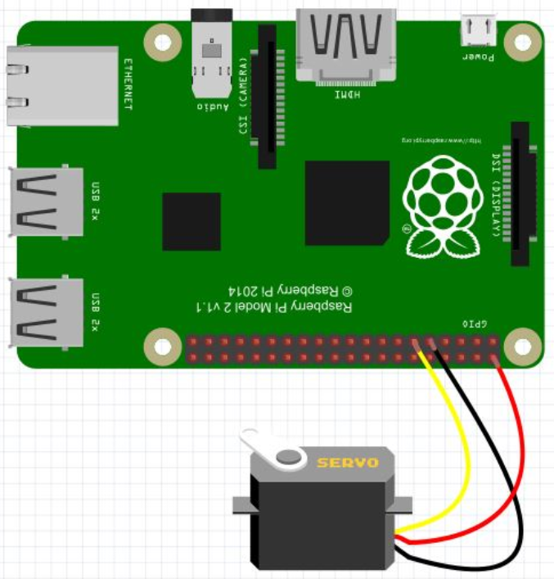
Assignment #1: Simple Servo Control-Python
Follow the instructions to wire and program a basic servo using your raspberry pi. Record your pi in action and save the video to the hand in folder.
Instructions:
Wire your servo to the GPIO(General Purpose Input Output) pins using the following diagram:

Slide 5
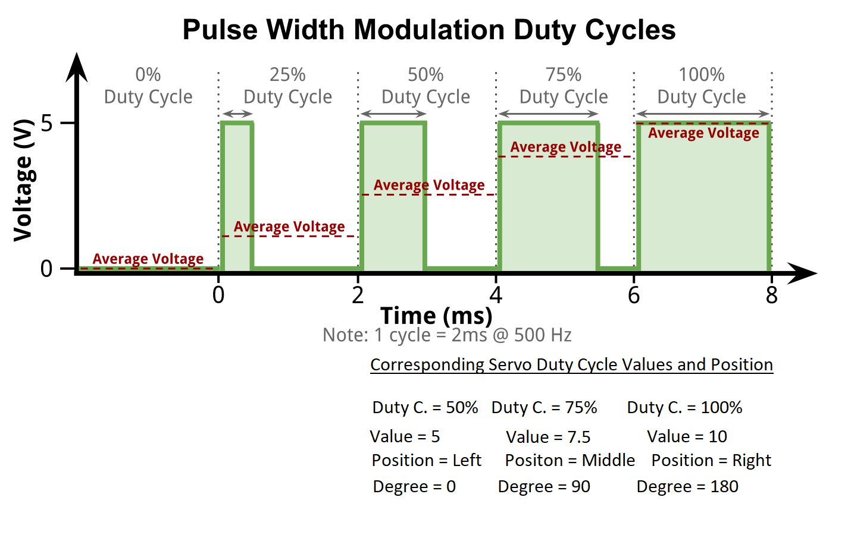
Explanation: Servo motors are controlled through PWM (Pulse Width Modulation). Servos will move to different positions based on the width between pulses. We will use Duty Cycle to change the Pulse Width. See the diagram below to understand how to control servo position based on pulse width. Note: Standard servos can be rotated to set points between 0 – 180 degrees.

Slide 6
b) Open the terminal on your raspberry pi and enter the following commands to run your servo using python.
sudo python
import RPi.GPIO as GPIO
GPIO.setmode(GPIO.BOARD)
GPIO.setup(11,GPIO.OUT)
pwm=GPIO.PWM(11,50)
pwm.start(5)
pwm.ChangeDutyCycle(7.5)
pwm.ChangeDutyCycle(10)
Your servo should first move to the left, then middle and then right.

Slide 7
Assignment #2: ClockWork Raspberry
In the first lesson we learned how to make the servo move. Now we will learn to expand our code and save it to a file.
Instructions:
Click on the Raspberrypi Icon in the top right corner of Raspbian.
Select Programming → Python 3(IDLE)
Click File New
Click File Save As
Enter “servoloop” and save the file to the Documents folder.

Slide 8
Enter the following code into your python file and save and close it when you are done.
import Rpi.GPIO as GPIO
import time
GPIO.setmode(GPIO.BOARD)
GPIO.setup(11,GPIO.OUT)
pwm=GPIO.PWM(11,50)
pwm.start(5)
counter = 0
while counter <= 10:
pwm.ChangeDutyCycle(7.5)
time.sleep(1)
pwm.ChangeDutyCycle(10)
time.sleep(1)
pwm.ChangeDutyCycle(7.5)
time.sleep(1)
pwm.ChangeDutyCycle(5)
time.sleep(1)
counter = counter + 1

Slide 9
g) Run your program by typing the following command in the terminal:
python /home/pi/Documents/servoloop.py
h) Record your results in a video and hand the video into the hand in folder.

Slide 10
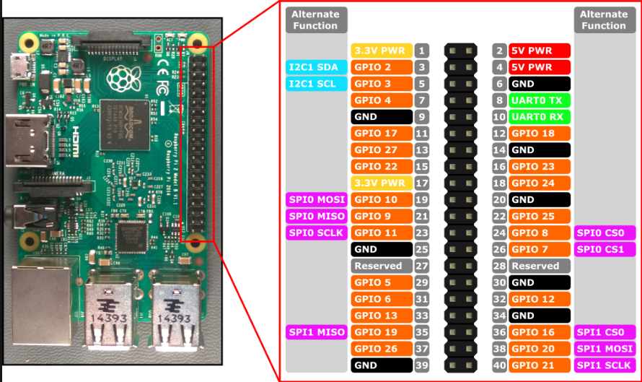
Assignment #3: Wired Robot
In the following assignment we will switch from a regular servo to two continuous servos with higher power requirements. The higher power requirements require a more complex wiring scheme. First lets get more familiar with the GPIO outputs of our Raspberry Pi 3. See the following diagram:

Slide 11
Our previously created program “servoloop.py” will run with a continuous servo as well. The difference being rather than moving to different positions it will go forward and backwards(and almost stopped on the middle value). Our continuous servos have higher power requirements than our regular servo which we were able to power directly from the 5V pin on the pi. If we just tried to power our continuous servo or even a more powerful regular servo through the Pi we could damage the Pi so we will have to use an external power source to power our servos from this point on. Wire up the continuous servo based on the instructions on the next page and then run your previous program “servoloop.py”.

Slide 12
Instructions:
Connect a 9V battery to a breadboard. Connect the positive terminal to the red line of the breadboard. Connect the negative terminal to the blue line of the breadboard.
Connect the power/positive(red) wire of your servo to the positive(red) line on the breadboard. Connect the ground(black/brown) wire of your servo to the blue line on the breadboard.
Connect one of the ground GPIO pins(see diagram on slide 10) to the blue line of the breadboard(The servo power and switch need to share a common ground).
Connect the switch wire(white/orange) of the servo to the pin 11(GPIO 17) on your Raspberry Pi. See diagram on slide 10(Pin #’s are in grey).
* Have the teacher check your wiring. Mistakes could wreck the Pi. See the diagram on the next slide to double check your wiring.
Run your program by once again typing the following in terminal:
python /home/pi/Documents/servoloop.py

Slide 14
The Challenge- Complete thE Robot
You now have all of the knowledge needed to make a wired robot with 2 continuous servos. Your challenge is to make a robot out of lego that goes forward for 1 second, stops for 1 second and drives back for 1 second. Repeat this pattern 5 times.
Tips:
Wire your second servo by connecting the switch wire(white or orange) to another available GPIO pin(maybe 13). Connect the power(red) to the red line on the breadboard and the ground(black) to the blue line of the breadboard.
Add the code needed to control the new servo.
Change the loop from 10 to 5.
For this robot you may want to just put the servos on the robot and keep the pi and the breadboard off of the robot. Otherwise wires may come unplugged when you run the program.

Slide 15
Assignment #4: Wireless Robot
It is now time to learn how to control the Raspberry Pi wirelessly. Use the following instructions to get it working.
Instructions for Pi:
In the terminal on your raspberry pi run the following command:
sudo raspi-config
b) This will open up Raspberry Pi Software Configuration Tool.
Open → Interfacing Options → SSH → Enable
c) Restart your Pi
Open terminal and run
sudo ifconfig
Under the wlan0: section write down the address next to inet or inet addr(it will look something like 192.__._.__.__

Slide 16
Instructions for Windows:
Download the putty exe or msi file for your brand of windows from here:
https://www.putty.org/
Install and run or just run putty(if you just got the .exe file)
Enter the ip address you obtained from item “e” on the previously slide under Host Name(or enter raspberrypi)
When prompted, login as: pi
Enter password: raspberry (You may want to use the rasp-config to change your user name and password in the future).
You now should be able to enter commands remotely just like you did when interfacing directly with the keyboard and mouse previously.
Enter the command from the previous assignment.
Ex.
python /home/pi/Documents/yourfilename.py
h) Video your working remote control robot.

Slide 17
Assignment #5: Procedural/Functional Bot
Lets now move our bot from a linear programming style to functional/procedural style.
In python we define functions like this:
def functionName():
# indent
# do something
#do something else
To call this do nothing function, I would type:
functionName()
Using this knowledge create forward, back, and stop methods. Change your Python script to a functional/procedural style of programming. Run your program and video both your code and the working Pibot.

Slide 18
Assignment #7: OOP?
You may not realize it but our program is already using many object oriented programming principles. First we are using libraries with our import statements at the top. Second we are creating instances of the GPIO.PWM classes and third we are calling there functions with ChangeDutyCycle. In a paragraph explain why object oriented programming is benefit in terms of programming robots.

Slide 19
Want More Credits?
You have completed this module but in the process you have been introduced to both Python and Raspberry Pi. If you have a project you would like to do with these new tools, talk to your teacher and come up with a project plan.

