Slide 1
CSE 1010
Computer Science 1
Prerequisite: None
Required Materials: Personal Headphones

Slide 2
Introduction
Students explore hardware, software and processes. This includes an introduction to the algorithm as a problem-solving tool, to programming languages in general and to the role of programming as a tool for implementing algorithms.
Tim Cook: Why Computer Science is important
Everyone Can Code

Slide 3
History of Canadian Technology
What is Technology?
Definition: a scientific or industrial process, invention, method, or the like.
New technologies continually change the way we live. I the following assignment we will exam technologies used by early Canadians and how the use of these technologies affected their lives. Assignment #1

Slide 4
Computer History
The past 100 years has been a very exciting time for technological advancement. At this pace it is almost impossible to predict where we will be in the future. In your first assignment, you will take a look at major advancements in computer science. Click here for Assignment #2

Slide 5
Evolution of Technology
New technologies emerge building on previous knowledge paired with new discoveries. Technology is not static and is always evolving. Choose a technology of your choice and track its evolution in Assignment #3

Slide 6
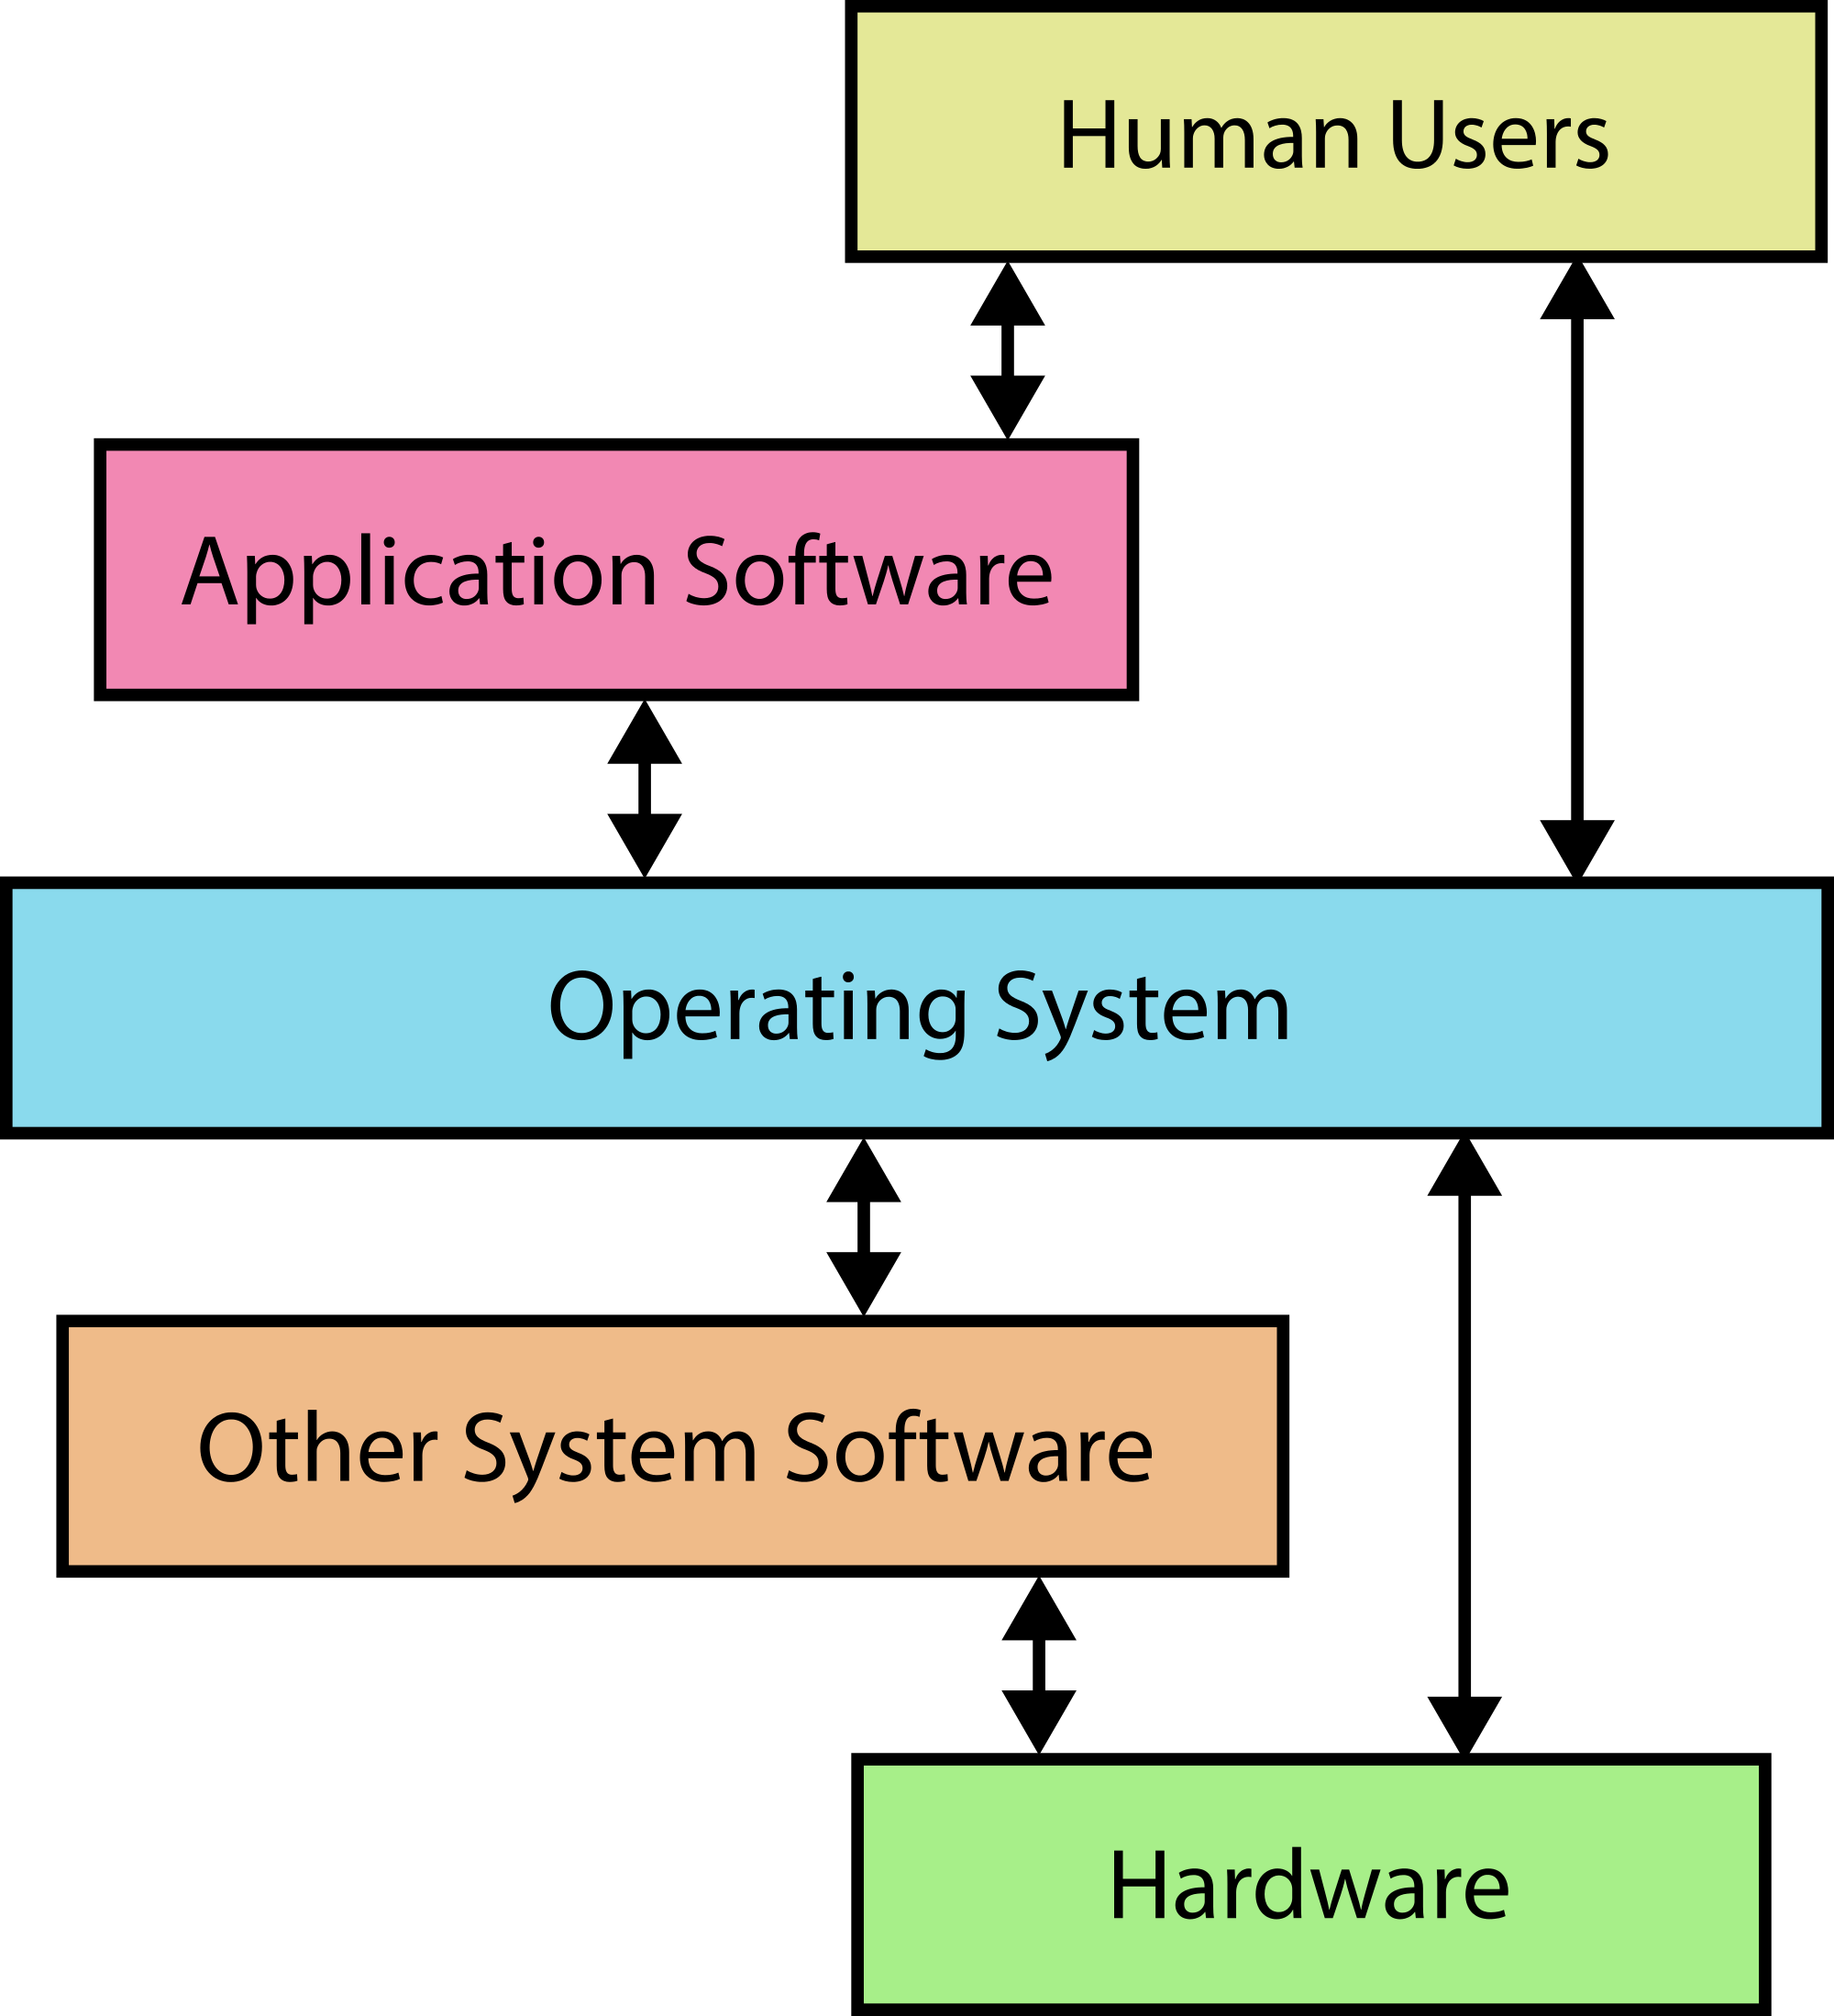
The Evolution of Computer Hardware and software
Like any other technology, computer hardware and software also continue to evolve over time. Often times the evolution of hardware has a direct impact on what can be done with software. The von Neumann Computer System Model allowed for easier programming and software development in the past. The recent release of Intel’s Ivy Bridge processors has allowed for PC’s to have similar battery life to tablets. Learn more about the evolution of software and hardware in Assignment #4
Check out these links:
https://www.youtube.com/watch?v=HEjPop-aK_w
https://www.youtube.com/watch?v=SiDU78vHsko

Slide 7
Careers in Computer Science
Now that you know a little bit of history about the computer industry, it is time to investigate some of the current careers in computer science. Learn more about different career opportunities through Assignment #5
Check out these links first:
http://wtkr.com/2016/05/17/study-finds-business-stem-degrees-are-the-most-in-demand-by-employers-in-2016/
https://www.youtube.com/watch?v=8FfKR1ksD94

Slide 8
Introduction to Computer Programming Logic
At its lowest level, computer programs make simple decisions. Get introduced to some simple computer programming logic through Assignment # 6
As a lead up to this assignment, view the following video:
Video Link
Also check out my Logic Notes

Slide 9
Introduction to Visual elements in Programming
After learning some basic computer logic, it is now time to learn how visual elements and/or GUI(Graphical User Interface) elements are displayed on your computer, tablet or smartphone screens. Every computer programming language is different, but there are many common elements and patterns. Learn how to display basic shapes in the “Processing Language” with Assignment #7

Slide 10
Learning Common Computer Algorithms
Algorithms are routines or instructions for a computer. Computer programmers use programming languages to communicate instructions to the computer. Programmers must become familiar with the syntax and patterns of the computer programming language that they are using. In Assignment #8 you will be introduced to some common computer algorithms.
Assignment Video Tutorial- Part A
Assignment Video Tutorial- Part B(1)
Assignment Video Tutorial- Part B(2)

